Slide 1
Review of Basic Meteorology

Slide 2
Weather results from differential heating and cooling of the Earth’s Surface.
Land heats and cools faster than water.
Areas receiving more direct solar radiation heat faster than those receiving less direct solar radiation.
The movement of air redistributes the heat energy.
Heat is transferred three ways:
Conduction - Heat transfer by direct contact
Convection - Heat transfer via a common air mass (often referred to as Advection when referring to horizontal transport).
Radiation - Heat transfer via the Electromagnetic spectrum, such as light or radio waves.

Slide 3
The greatest amount of solar energy is received when the Sun is directly overhead. Energy from the Sun is dispersed over a greater area when the Sun is not directly overhead.
More Dispersed
More Compact

Slide 4
The atmosphere, being composed of gasses, follows the General Gas Laws, which explain the relationships between Pressure, Temperature, and Volume of a given mass of a gas.
Let’s look at two columns of atmospheric air. For the next few examples, we will look at columns from the surface (approximately 1000mb in this example to simplify the math,) to 500 millibars, which is approximately the lower half of the atmosphere.
- 500mb -
- 1000 mb -

Slide 5
If we cool a column of air, the gas laws tell us that we should expect that column of air to have less volume than it had originally. If we heat the column of air, we should expect that column to have more volume than it had originally.
- 500mb -
- 500mb -
- 1000 mb -
- 1000 mb -
Cooling the air causes the height of the column of air to decrease
Warming the air causes the height of the column of air to increase

Slide 6
Because of the differences in heights of the columns, the height of the 500mb surface of the warm column is now above the height of the 500 surface of the cold column
- 500mb -
- 500mb -
The 500mb level of the warmer column is higher than the 500mb level of the colder column
- 1000 mb -
- 1000 mb -

Slide 7
As the pressure at the 500mb altitude of the warmer column is higher than the pressure at the same altitude of the colder column, air aloft begins to flow from the warmer column to the colder column.
- 500mb -
- 500mb -
- 1000 mb -
- 1000 mb -
As the height difference is due to temperature, greater temperature differences will result in greater height differences, which will result in a greater flow aloft.

Slide 8
As the surface pressure is related to the weight of the column of air above the surface, the increase in mass due to the inflow from the warmer column results in an increase in the surface pressure of the colder column, and decrease in surface pressure in the warmer column.
- 500mb -
- 500mb -
> 1000 mb
< 1000 mb
This difference in pressure at the surface induces a flow from the colder column to the warmer column.

Slide 9
The horizontal flows induce vertical flows as well.
- 500mb -
- 500mb -
> 1000 mb
< 1000 mb -
If there were no other effects, equilibrium would eventually be achieved as the air from the two columns is mixed by this circulation.

Slide 10
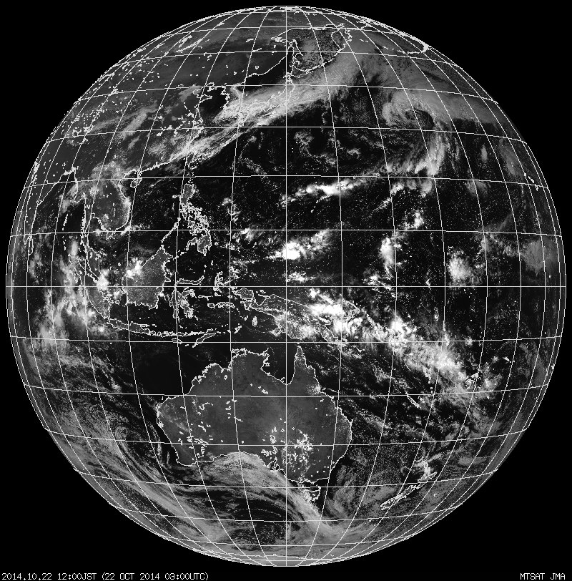
As the world is round, air does not move in a direct path from higher pressure to lower pressure. Instead, it follows a curved path as described by the Coriolis Effect, which accounts for conservation of angular momentum.

Slide 11
At the equator, the earth rotates at approximately 900 knots. (360 degrees* 60 nautical miles per degree divided by 24 hours in a day, with a correction of less than a degree per day due to the Earth’s rotation around the sun.) At any other latitude, the speed of rotation is approximately 900 knots * the cosine of the latitude. Thus, as a particle (or air mass) moves away from the Equator, it will be travelling faster than the underlying Earth, and appear to move toward the east of its intended path, and, as a particle (or air mass) moves toward the Equator, it will be moving slower than the underlying Earth, and appear to move toward the west of its otherwise expected path. Both of these cases result in an apparent deflection to the right in the northern hemisphere, and to the left in the southern hemisphere.
Pole: 0 knots
60 Degrees: Approx. 450 knots
45 Degrees Latitude: Approx. 636 Knots
Shreveport: Approximately 759 Knots
30 Degrees Latitude: Approx. 779 Knots
Tampa FL: Approx. 795 Knots
Equator: Approx. 900 kts.

Slide 12
The result of the apparent deflection is a counter clockwise flow around low pressure centers and clockwise flow around high pressure centers in the Northern Hemisphere. Regardless of the hemisphere, though, the flow around a low pressure center is referred to as cyclonic, and around a high pressure center as anti-cyclonic.
Resulting Flow
Resulting Flow
H
L
Without Coriolis
Without Coriolis
Without Coriolis
Resulting Flow
Resulting Flow
Northern Hemisphere Example

Slide 13
In the mid latitudes of the upper troposphere, the winds resulting from the temperature disparities between the arctic regions and the tropics generally flow from the west to the east, with their strength somewhat related to the average temperature gradients of the air masses.
Without Coriolis
Resulting from Coriolis

Slide 14
The Three-Cell theory is used to explain the predominant circulations in the Troposphere.
Three cells per hemisphere are theorized.
  Hadley cell from the equator to 30° latitude.
  Ferrel cell from 30° latitude to 60° latitude.
  Polar cell from 60° latitude to the poles.
Polar
Ferrel
Hadley

Slide 15
Hadley Cell
Heating and the resulting convection at the Inter-Tropical Convergence Zone causes the air to rise and flow poleward aloft.
The Coriolis effect deflects the air eastward.
The air sinks near 30° latitude, and flows poleward and equatorward. The equatorward flow is a return flow.
Northern hemisphere winds will be southwesterly aloft and northeasterly at the surface.
Southern hemisphere winds will be northwesterly aloft and southeasterly at the surface.

Slide 16
Polar Cell
Cooling at the poles causes the air to sink and flow equatorward at the surface.
The Coriolis effect deflects the air westward.
The air is warmed and rises near 60° latitude, and flows poleward.
The Coriolis effect deflects the air eastward.
Northern hemisphere winds will be northeasterly at the surface and southwesterly aloft.
Southern hemisphere winds will be southeasterly at the surface and northwesterly aloft.

Slide 17
Ferrel Cell
The Hadley Cell induces a downward flow near 30° and the polar cell induces an upward flow near 60° latitude.
A south to north circulation is induced at the surface in the northern hemisphere.
The Coriolis effect deflects the air eastward.
Winds will be generally westerly both at the surface and aloft.
Transient weather systems disrupt the flow.

Slide 18
Three Cell Theory
Rising air at the Inter-Tropical Convergence Zone results in low surface pressure near the equator.
Descending air near 30° latitude results in a surface subtropical high.
Rising air near 60° latitude results in low pressure at the surface.
Descending air at the poles results in high pressure.

Slide 19
If the Earth had a uniform composition, (or at least a uniform specific heat coefficient at the surface,) the airflow around the earth’s surface would be uniform at a given altitude.
Cool Polar Regions
Warm Tropics

Slide 20
Differences in surface heating and cooling result in different thicknesses of the air columns, which result in non-uniform wind flow aloft.
Cold Pocket at the Surface
Warm Pocket at the Surface

Slide 21
Areas of confluent flow and diffluent flow will be present in the upper level wind flow.
Cold Pocket at the Surface
Diffluence
Confluence
Warm Pocket at the Surface

Slide 22
Convergent Flow
Divergent Flow
Approximately 14,000 Feet
H
L
Surface pressure systems (highs, lows, troughs, and ridges) are often formed by the flow aloft. A divergent flow aloft will remove mass from the column of air, resulting in lower pressure at the surface. The divergent flow aloft will also result in upward motion under the divergent flow. A convergent flow aloft will add mass to the air column, resulting in higher pressures at the surface, and downward motion under the convergent flow.

Slide 23
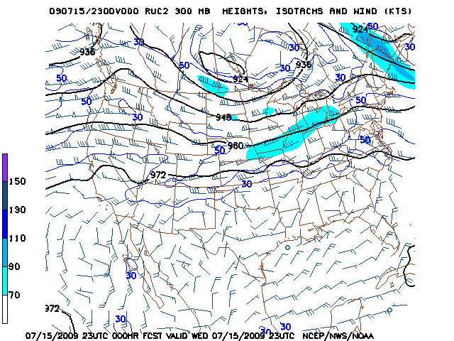
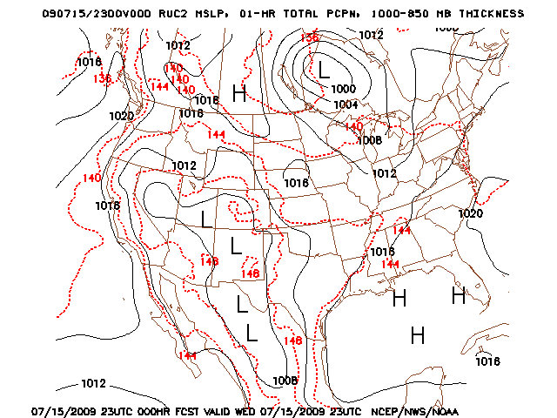
The diffluent flow on the 300mb chart corresponds with low pressure at the surface
The heat lows over the desert correspond with the higher heights and resulting anti-cyclonic circulation aloft

Slide 24
Convergence and Divergence aloft can be due to speed and/or direction of the wind flow.
 | Speed | Directional
Convergence | Upstream wind has a greater velocity than downstream wind. | Winds blow toward each other.
Divergence | Downstream wind has a greater velocity than upstream wind. | Winds blow away from each other.

Slide 25
The density of air is related to its pressure, temperature, and molecular weight. Although water in a liquid form is more dense than air, water in its vapor form is less dense than dry air, as its molecular weight of 18 is less than the average molecular weight of the atmosphere of 30.
N
N
14 + 14 = 28 (~78%)
H
H
O
O
O
1 + 16 + 1 = 18 (Percentage varies)
16 + 16 = 32 (~21%)
(Other gases of various weights make up about 1 %)

Slide 26
Dry air is more dense than moist air. Thus, when dry air and moist air are together, the moist air will tend to rise and the dry air will tend to sink, all else being equal. Thus, air masses classified as Continental will be more dense than air masses classified as Maritime if their temperature profiles are similar.
Cold air is more dense than warm air. Thus, when cold air and warm air are together, the warm air will tend to rise and the cold air will tend to sink, all else being equal. Thus, Arctic air masses will be more dense than Polar air masses, and Polar air masses will be more dense than Tropical air masses, provided that their moisture profiles are similar.

Slide 27
If a cold air mass moves over a warmer surface, the lower part of that air mass will be warmed. This decreases the density near the bottom of the air mass, and makes the air less stable. The warmed air will rise through the rest of the air mass until it reaches equilibrium.
Cold Air Mass over
warmer surface (Unstable)
If a warm air mass moves over a cooler surface, the lower part of that air mass will be cooled. This increases the density near the bottom of the air mass, and makes the air mass more stable. If the surface is cooler than the dew point of the warm air mass, fog may form.
Warm Air Mass over
cooler surface (Stable)

Slide 28
Warm air rising through a cooler air mass will expand and cool as it rises. If it cools to its dew point, clouds will form. If the surface dew point is close to the surface temperature, the air mass will reach the dew point at a relatively low altitude, resulting in low clouds. If the dew point spread is large, clouds will form at a higher altitude.

Slide 29
If the dew point in a warm air mass is higher than the temperature of the ground under the air mass, fog may form. If the wind is calm, there may not be enough mixing for fog to form. If the winds are very light, the fog may be shallow. If the winds are too strong, the air mass may not remain over the colder surface long enough for fog to form.

Slide 30
Boundaries between air masses are known as “fronts”. If the cold air is advancing, the leading edge of the cold air mass is called a “cold front”. If the cold air is receding, the trailing edge of the cold air mass is called a “warm front”.
Air Flow
Cold Air
Warm Front
Cold Front
Warm Air

Slide 31
The cold air behind a cold front is relatively shallow. The warm air above the front is lifted as the cold air advances, resulting in adiabatic cooling. If the warm air contains enough moisture, clouds will form.
Cold Front at the surface
Cold air mass movement

Slide 32
The cold air ahead of a warm front is more shallow than that behind a cold front. The warm air above the front is lifted as it moves over the colder air, resulting in adiabatic cooling. If the warm air contains enough moisture, clouds will form.
Warm Front at the surface
Warm air mass movement
Cold air mass movement

Slide 33
Precipitation generally forms through one of two processes.
The Warm Rain process occurs when liquid water droplets coalesce into larger droplets, and eventually fall due to their weight. This occurs at temperatures warmer than freezing
The Cold Rain process occurs when ice crystals coalesce into larger crystals, and eventually fall as snow or hail due to their weight. This occurs at temperatures below freezing. If the snowflakes or hailstones fall through a layer of air of sufficient warmth and depth, they melt into raindrops.

Slide 34
Freezing Level
If the freezing level is above the cloud tops, and the cloud is deep enough, the water droplets coalesce, and eventually fall to the ground as liquid precipitation.

Slide 35
If the cloud tops are significantly above the freezing level, and the thickness of the cloud above the freezing level is deep enough, the ice crystals coalesce, and eventually begin to fall as snow. If the freezing level is high enough, the snow will melt on its way down and fall to the ground as liquid precipitation.
*
*
*
*
*
*
*
*
*
*
*
*
*
*
*
*
*
*
*
*
*
*
*
*
*
*
*
*
*
*
*
*
*
*
*
*
*
*
*
*
*
*
*
*
*
*
*
*
*
*
*
*
*
*
*
*
*
*
*
*
*
*
*
*
*
*
*
*
*
*
*
*
*
*
*
*
*
*
*
*
*
*
*
*
*
*
Freezing Level
*
*
*
*
*
*

Slide 36
*
*
*
*
*
*
*
*
*
*
*
*
*
*
*
*
*
*
*
*
*
*
*
*
*
*
*
*
*
*
*
*
*
*
*
*
If the freezing level is near the ground, and the cloud is deep enough, the ice crystals coalesce, and eventually begin to fall as snow or hail.
*
*
*
*
*
*
*
*
*
*
*
*
*
*
*
*
*
*
*
*
*
*
*
*
*
*
*
*
*
*
*
*
*
*
*
*
*
*
*
*
*
*
*
*
*
*
*
*
*
*
*
*
*
*
*
*
*
*
*
*
*
*
*
*
*
*
*
Freezing Level

Slide 37
If liquid precipitation falls through a layer of air with a temperature below freezing, freezing precipitation and/or ice pellets may result, depending upon the thickness of the layer and its proximity to the ground. Icing should be expected in the cold layer in these instances.
If snow falls through a shallow warm layer and then back into a layer with a temperature below freezing, snow grains may result.

Slide 38
Weather Symbols

Slide 39
Weather products frequently use symbols in place of text. This allows information to be conveyed more efficiently than if it were text, and also makes the data language-independent.

Slide 40
Common Symbols
H
H
H
L
L
Surface Low
Upper-Level Low
Surface High
Upper-Level High
Trough
Ridge
Hurricane, Willy Willy, Typhoon, etc.
Tropical Storm
Tropical Depression

Slide 41
Front Symbols
Cold Front
Warm Front
Surface
Aloft
Surface
Aloft
Stationary Front
Occluded Front

Slide 42
Weather Symbols
+
=
Thunder
(Airways)
Lightning
Thunderstorm
Symbols are combined to yield a more complete picture of what is or was occurring at the weather station.
,
*
( )
Rain
Drizzle
Ice Pellets or Hail
Snow
= Rain showers in the vicinity
]
=Thunderstorm with hail or ice pellets
( )
Vicinity
Showers
Within the past hour, but not at the present time.
Freezing
]
=Freezing rain during the past hour

Slide 43
Obstructions to Vision symbols
Visibility must be less than 7 miles.
Haze
Fog
(visibility <5/8 mile)
Mist
(visibility >=5/8 mile)
Smoke

Slide 44
METARS

Slide 45
Example METAR observations
KAEX 291413Z 36005KT 3SM BR OVC002 19/19 A3011 RMK AO2 T01940194
KBAD 291358Z AUTO 02008KT 10SM CLR 15/13 A3018 RMK AO2 SLP222 T01520128
KBTR 291409Z 6SM BR SCT002 21/20 A3011 RMK AO2 T02060200
KDTN 291353Z 04007KT 10SM CLR 16/12 A3018 RMK AO2 SLP219 T01560122
KHDC 291415Z AUTO 29005KT 10SM CLR 22/21 A3013 RMK AO2
KHUM 291350Z 00000KT 5SM BR SKC 21/21 A3010 RMK ATIS P VA RY18 RY12/30 CLSD RC
KLCH 291416Z 00000KT 3SM BR BKN075 21/21 A3010 RMK AO2 T02110206
KLFT 291353Z 00000KT 6SM BR BKN075 19/19 A3011 RMK AO2 SLP194 T01940194
KMLU 291353Z 01008KT 10SM OVC039 15/13 A3017 RMK AO2 SLP215 T01500133
KMSY 291353Z 34004KT 10SM FEW015 FEW250 23/21 A3010 RMK AO2 SLP195 CB DSNT SW T02280206 $
KNBG 291407Z 00000KT 1 1/2SM BR SCT005 SCT015 BKN250 22/20 A3010 RMK AO2 T02170200 $
KNEW 291413Z 31003KT 2 1/2SM BR OVC003 22/21 A3011 RMK AO2 T02220206
KOPL 291415Z AUTO 00000KT 4SM HZ OVC002 A3011 RMK AO2
KPOE 291428Z AUTO 36006KT 5SM BR OVC004 19/19 A3012 RMK AO2
KRSN 291415Z AUTO 02006KT 10SM SCT039 OVC085 14/13 A3021 RMK AO2 T01420134
KSHV 291356Z 02008KT 10SM FEW012 SCT070 16/13 A3018 RMK AO2 SLP216 T01610128

Slide 46
Reporting requirements are not uniform.
CD STATION ICAO IATA SYNOP LAT LONG ELEV M N V U A
LA MINDEN KMNE MNE 32 39N 093 18W 85 X W
LA MONROE KMLU MLU 32 31N 092 02W 29 X U A
LA NATCHITOCHES KIER IER 31 44N 093 06W 37 X
LA NEW IBERIA KARA ARA 30 02N 091 53W 18 X T A
LA NEW ORLEANS/LAKE KNEW NEW 30 03N 090 02W 3 X T A
LA NEW ORLEANS NAS KNBG NBG 29 49N 090 01W 1 X T
LA NEW ORLEANS/INTL KMSY MSY 72231 30 00N 090 15W 5 X T A
LA HARVEY/N ORLEANS KHRV HRV 29 51N 090 00W 1 V
LA OAKDALE ALLEN P KACP ACP 30 45N 092 41W 33 X W
LA RUSTON REGIONAL KRSN RSN 32 31N 092 35W 95 X A
LA PATTERSON MEMORI KPTN PTN 29 43N 091 19W 3 X
LA SALT POINT KP92 P92 29 34N 091 32W 1 X A
LA SHIP SHOAL 207 KGSM GSM 28 32N 090 59W 1 X W
LA SHREVEPORT/DWNTN KDTN DTN 32 33N 093 45W 53 X T A
LA SHREVEPORT KSHV SHV 72248 32 27N 093 50W 83 X X T X A
LA SHREVEPORT(VOR) KEIC EIC 32 46N 093 49W 80 V
LA SLIDELL/88D KLIX LIX 72233 30 20N 089 50W 7 X X
LA SLIDELL 22 KASD ASD 30 21N 089 49W 9 X T A
LA NEW ORLEANS RFC KORN ORN 30 15N 089 46W 3
LA S MARSH ISLAND K7R8 7R8 28 18N 091 58W 1 X W
LA SULPHUR KUXL UXL 30 08N 093 23W 4 X

Slide 47
Wind Observations
Wind direction is reported using a 360 degree circle with North being 360 degrees, East being 90 degrees, South being 180 degrees, and West being 270 degrees. The direction reported will be the direction the winds are blowing FROM, so that aviators know which direction to turn to get the desired headwind for take-off and landing.

Slide 48
09
As an example, if the winds were from the West at 10 knots, it would be preferable for aircraft to land and depart heading toward the West
In this example, Runway 27 would be the preferred runway.
27

Slide 49
METAR Wind Reports
The first three digits of the METAR wind report are the direction the wind is blowing from.
The next two digits are the wind speed.
If there are gusts, a “G” will follow the wind speed, followed by the highest wind speed during the fifteen minutes prior to the observation valid time.
The wind group ends with the units that the speed is given in, such as KT for Knots, or MPS for Meters per Second.

Slide 50
Example: 18012G25KT
Winds are from 180 degrees (from the south, or southerly)
Average wind speed is 12 knots.
Highest gust during the past 15 minutes was 25 knots.
Phraseology: “Winds are from one eight zero at twelve knots gusting to twenty five knots.”

Slide 51
Peak Wind
If wind speeds exceed 25 knots (26 knots or more,) during the hour and that speed is not reported in the body of the METAR, a Peak Wind remark will be included in the observation.
The format for a Peak Wind is “PK WND” followed by the direction and speed (without unit indicator), then a solidus, then the time of the peak wind.

Slide 52
Example: PK WND 17031/25
Wind direction of the peak gust was from 170 degrees.
The peak speed was 31 knots.
The peak wind occurred at 25 minutes past the hour. In some instances, four digits indicating the time will be used.

Slide 53
Wind Measurement
Data can be obtained through a fixed sensor, preferably located near the runway.
Measurements may be taken using a handheld/portable anemometer.
Charts and tables exist to estimate wind if sensors are not available.

Slide 54
Wind Variability
If the wind direction varies by 60 degrees or more during the observing period, and the wind speed is six knots or less, the wind direction may be reported as VRB (such as, VRB05KT).
If the wind direction varies by 60 degrees or more during the observing period, and the wind speed greater than six knots, the predominant direction is reported, and the limits of variability follow (such as 31010KT 270V340).

Slide 55
Wind Shift Remark
Defined as a 45 degree or more change in predominant wind direction in less than 15 minutes, with winds sustained at 10 knots or more through the shift.
Reported in Remarks as WSHFT followed by the minutes (and hours, if needed,) of the beginning of the occurrence. If associated with frontal passage, FROPA may be appended to the remark.

Slide 56
Surface Wind Plots
Winds from the Northwest at 10 knots,
or Winds from 320 at 10 knots
Calm Winds
Winds from the south at 2 knots, or Winds from 180 at 2 knots.
Winds from the east at 5 knots, or Winds from 090 at 5 knots.
Winds from the southwest at 50 knots, or Winds from 220 at 50 knots.

Slide 57
Visibility
When observed by humans, it is the distance that an object (during the day) or unfocused light (at night) can be seen through at least half of the horizon circle.
ASOS uses an unfocused light and a nearby sensor to convert received light values to equivalent visibility values.

Slide 58
Visibility Reporting
Can be reported in Meters or Statute Miles. Generally, Statute miles is used in the United States. Most of the rest of the world uses Meters.
The highest reportable value in Statute Miles is 95SM
The highest reportable value in Meters on METARS is 9999.

Slide 59
Visibility Reporting (cont.)
Tower visibility may be reported in remarks if it differs from surface visibility.
Some stations may report surface visibility in remarks and use tower visibility as prevailing if tower visibility is lower than surface visibility.
Visibility may be reported as Variable in Remarks if it is less than three miles (such as VIS 1/2V2).

Slide 60
Visibility Plots
2 1/2
58
Visibility is plotted directly to the left of the station circle. Most charts from US sources will use actual visibility in statute miles.
On some charts plotted from synoptic code, the synoptic code for the visibility will be plotted instead of the actual visibility.
If the code is 50 or less, the visibility is in hundreds of meters. For example, 32 would be 3200 meters, or 2 miles.
If the code is more than 50, subtract 50 and result will be visibility in kilometers. For example, 66 would be 16 kilometers, or 10 miles.

Slide 61
Runway Visual Range
Calculated by sensors aligned with the runway.
Reported whenever the prevailing visibility is 1 statute mile or less and/or the RVR for the designated instrument runway is 6,000 feet or less.
A single value or range of values may be reported

Slide 62
Runway Visual Range Format
Formatted as R, then the runway designator, then a solidus, then a single value or the lowest value, followed by a V, then the highest value, ending with FT.
M is used to mean Less Than, and P is used to mean Greater Than.
Examples:
  R27L/M0400FT – Runway 27 Left visual range is less than 400 feet.
  R18/0600V1000FT – Runway 18 visual range varies from 600 feet to 1000 feet.
  R36C/5000VP6000FT – Runway 36 Center visual range varies from 5,000 feet to greater than 6,000 feet.

Slide 63
Weather and Obstructions to Vision
Obstructions to Vision are phenomena that reduce visibility, such as mist, fog, haze, smoke, etc.
Precipitation, tornadic activity, etc. are considered Weather. Weather may or may not reduce visibility.

Slide 64
Weather and Obstructions to Vision
Although there are thumb rules for determining whether an obscuration is haze or mist based on dew-point depression, the true difference is that mist/fog are based on moisture, haze is not.
Fog can quickly form if supersaturated calm air is disturbed. This sometimes happens soon after sunrise as the heated ground triggers convective currents.

Slide 65
Weather
If weather is occurring within five miles of the point of observation, it is considered to be occurring “on-station”
If weather is occurring between five and ten miles from the point of observation, it is considered to be “in the vicinity”
If weather is observed but is more than ten miles from the point of observation, it is considered to be “distant”.

Slide 66
Weather and Obstruction to Vision Plots
*
,
3
1/2
Symbols for weather are plotted between the visibility and the station circle. Only the most significant symbol is plotted.
Past weather, for the previous 3 or 6 hours, may be plotted to the lower right of the station circle on charts derived from synoptic observation data.

Slide 67
Weather Remarks
Lightning
Precipitation begins and/or ends
Thunderstorm begins and/or ends
Thunderstorm location and movement.
Hailstone size
Virga (Precipitation not reaching the ground)
Snow Increasing Rapidly

Slide 68
Lightning
Reported as Frequency Type Location
Frequency – OCNL, FRQ, CONS
Type – CG, IC, CC, CA
Location – Direction, ALQDS, OHD
Examples:
  OCNL LTGIC W
  FQT LTGICCG ALQDS

Slide 69
Sky Condition
Refers to the amount and height of clouds and/or obscurations covering the celestial dome.
Observed differently by humans and automated stations.

Slide 70
Sky Condition Evaluation - Human
Humans evaluate the entire “celestial dome,” estimating cloud amounts as if they were on a dome over the observer.

Slide 71
Sky Condition Evaluation – ASOS/AWOS
Automated systems evaluate the sky either directly overhead or in a small radius overhead, estimating amounts by time the cloud is overhead.

Slide 72
Sky Condition Terms
SKC (Sky Clear) means no clouds
CLR (Clear) means no clouds below 12,000 feet observed by an automated sensor
FEW means there are clouds with less than 25% coverage
SCT (Scattered) means there are clouds with 25% to 50% coverage
BKN (Broken) means that there are clouds with more than 50% but less than 100% coverage.
OVC (Overcast) means that the clouds cover 100% of the celestial dome.
VV (Vertical Visibility) means that the sky cannot be seen, and objects higher than that level would not be visible from the ground.

Slide 73
Sky Condition Terms (cont.)
A layer is all of the clouds with bases at a single altitude, such as FEW008 or SCT020.
A ceiling is the lowest BKN, OVC, or VV layer. If there are no BKN, OVC, or VV layers, there is no ceiling.
The Sky condition is the total of all layers.

Slide 74
Sky Condition Terms
As an FYI –
In the old Airways code, (preceded the METAR code in the United States,) the codes for an indefinite ceiling at the surface with zero visibility in fog were W0 X 0F, generally pronounced “wocks off.”

Slide 75
Sky Condition Example
FEW008 SCT020 BKN035 OVC070
There are four layers.
The ceiling is 3,500 feet AGL.
Blue Sky/Stars not visible from the surface.

Slide 76
Sky Condition Example
FEW020 SCT035
There are two layers.
No ceiling.
Blue Sky/Stars visible from the surface.

Slide 77
Sky Condition Example
VV000
There is one layer.
Ceiling is at the surface.
Blue Sky/Stars/other clouds not visible from the surface.

Slide 78
Significant Cloud Types
If a layer contains a Cumulonimbus cloud, CB will be appended to the layer, such as BKN008CB.
If a layer contains Towering Cumulus, TCU will be appended to the layer, such as SCT015TCU.
CB, CBMAM, TCU, ACC, and ACSL clouds will be annotated in remarks.

Slide 79
Sky Condition Variability
Variable ceiling height will be included in remarks. Example: CIG 004V007.
Variable Sky Condition (pertaining to an individual layer) will be included in remarks when operationally significant. Example: BKN015 V SCT.
It is prudent to assume worst case when considering variable sky conditions unless the trend is toward improvement.

Slide 80
Sky Condition Plotting
There are a lot of different methodologies for depicting Sky Condition.
A common ADDS chart color codes the station circle based on flying condition, regardless of sky coverage.
Different depictions were used for the old Airways code and Synoptic code. The old Airways code is occasionally still used.

Slide 81
Synoptic Sky Coverage Plots
= Clear
= 5/8th
= 1/8th
= 6/8th
= 2/8th
= 7/8th
= 3/8th
= 8/8th or Overcast
= 4/8th
= Sky Obscured

Slide 82
Significant Synoptic Cloud Types
Towering Cumulus
Cumulonimbus
without Anvil
Cumulonimbus with Anvil
Altocumulus Standing Lenticular
Low cloud types will be plotted beneath the station circle, while mid and high cloud types will be plotted above the station circle. If more than one type of cloud exists in a level, only the most significant will be reported/plotted.

Slide 83
Temperature
Reported in Celsius
Reported in body of METAR as Temp/Dewpoint, in whole degrees, with M preceding negative values.
Reported in Remarks to the nearest tenth of a degree Celsius.
Displayed on some U.S. charts in Fahrenheit.
Dew Point Depression is the difference between temperature and dew point, and is always positive.

Slide 84
Temperature in Remarks
Indicators, 0 means positive, 1 means negative.
Indicates Temperature in Tens, Units, and Tenths. In this case, the temperature is 2.3 degrees C.
Indicates Dew Point in Tens, Units, and Tenths. In this case, the temperature is negative 5.6 degrees C.
Example: T00231056

Slide 85
Temperature in Remarks
Example: T00231056
The Dew Point Depression in the above example would be 7.9 degrees Celsius. (2.3 – (-5.6) = 7.9)
Example: T10231056
The Dew Point Depression in this example would be 3.3 degrees Celsius. (-2.3 – (-5.6) = 3.3)

Slide 86
Temperature Plots
Temperature is always plotted to the upper left of the station circle.
Dew point is always plotted to the lower left of the station circle on surface charts.
20.1
10
The temperature scale may be Celsius or Fahrenheit, depending upon the source of the chart. The temperature may be reported to the nearest degree or nearest tenth of a degree.
Note – On Upper Air charts, dew point depression is plotted instead of dew point.

Slide 87
Pressure
Many different pressure reports are possibly present in a METAR observation:
  Altimeter Setting
  Sea Level Pressure
  Pressure change and tendency

Slide 88
Pressure
Station pressure is measured using a Barometer. Other pressure values are computed from this value, station elevation, current temperature, and/or past temperatures.

Slide 89
Altimeter Setting
The setting for the altimeter at which the altimeter would show field elevation if the aircraft were on the ground.
Reported in tens, units, tenths, and hundredths, without the decimal point.
First digit will be a two or three.
Follows temperature in METAR observations, with leading A.
Example: A3012 would be read “Altimeter Setting three zero point one two inches.”

Slide 90
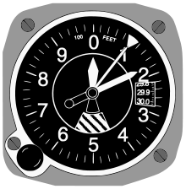
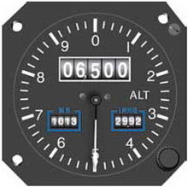
Altimeter Setting.
The pilot enters the altimeter setting in the Kollsman window to ensure that the altimeter reads the correct altitude with current pressure.

Slide 91
Sea Level Pressure
Standard sea level pressure is 1013.2 hectopascals.
Included in remarks as SLP followed by the tens, units, and tenths digit. Example: 1013.2 would be encoded SLP132. The leading digit(s) are dropped as they can be easily deduced.
Used by meteorologists, forecasters, and synoptic analysts to understand large scale circulations.
Will usually not correspond to Altimeter Setting unless the station is near standard atmosphere.

Slide 92
Sea Level Pressure Examples
SLP032 = 1003.2 hPa, as 1003.2 is closer to 1013.2 than 903.2.
SLP324 = 1032.4 hPa, as 1032.4 is closer to 1013.2 than 932.4.
SLP752 = 975.2 hPa, as 975.2 is closer to 1013.2 than 1075.2.
SLP990 = 999.0 hPa, as 999.0 is closer to 1013.2 than 1099.0

Slide 93
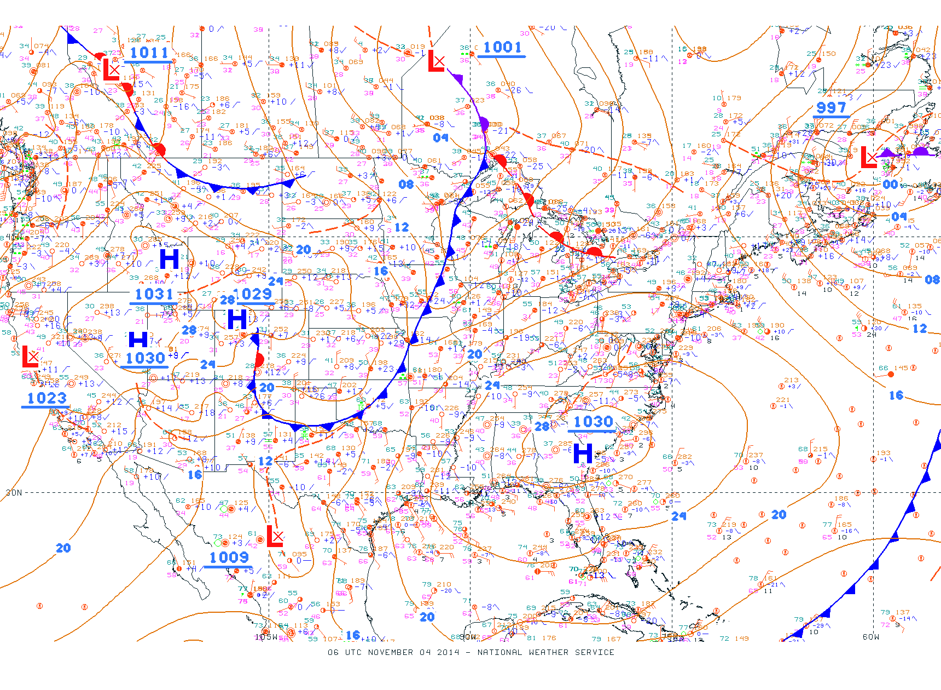
Example Isobaric Analysis from Surface Plots

Slide 94
Three-Hour Pressure Tendency
Amount and type of pressure change during previous three hours.
Five digit group, with 5 as first digit.
Next digit indicates change direction.
Last three digits are change in millibars/hectopascals in tens, units, and tenths.

Slide 95
Three-Hour Pressure Tendency (cont.)
Examples:
50012 – Pressure rising then decreasing, 1.2 hectopascals higher than three hours ago.
56012 – Pressure falling then steady, 1.2 hectopascals lower than three hours ago.
55000 – Pressure decreasing then increasing, same as three hours ago.
54000 – Pressure steady during the past three hours.

Slide 96
Three-Hour Pressure Tendency codes
0 – Increasing then decreasing; higher or no change
1 – Increasing then steady; higher
2 – Increasing; higher
3 – Decreasing then increasing; higher
4 – Steady, no change
5 – Decreasing then increasing; lower or no change
6 – Decreasing then steady; lower
7 – Decreasing; lower
8 – Increasing then decreasing; lower

Slide 97
Pressure Plots
132
05
Typically, the Sea Level Pressure in tens, units, and tenths is plotted to the upper right, and pressure change and tendency to the center right of the station circle. The tendency and pressure change may be reversed. Charts used for purposes other than synoptic analysis may omit this data.

Slide 98
Automated Sensor Remarks
RVRNO – RVR sensor not operating
PWINO – Present weather sensor not operating.
PNO – Precipitation amount sensor not working.
FZRANO – Freezing precipitation sensor not working.
TSNO – Lightning detector not working.
VISNO – Secondary visibility sensor not working.
CHINO – Secondary ceiling height indicator not working.
$ - Maintenance needed.

Slide 99
985
25
][
008
2 1/2
21
4
KFTW
Sample Station Model

Slide 100
985
25
][
008
2 1/2
21
The completely filled in station circle indicates OVERCAST skies
4
KFTW

Slide 101
Winds are FROM approximately 330 degrees
985
25
][
008
2 1/2
21
4
KFTW

Slide 102
One long bar (10 knots) and one short bar (5 knots) means approximately 15 knots. (actually 13-17 knots)
985
25
][
008
2 1/2
21
4
KFTW

Slide 103
Temperature in Celsius
985
25
][
008
2 1/2
21
Dew Point in Celsius
4
KFTW

Slide 104
The tens, units, and tenths of the sea level pressure in hectopascals is plotted. For instance, a pressure of 998.5 would be plotted as 985 and a pressure of 1013.2 would be plotted as 132.
985
25
][
008
2 1/2
21
4
KFTW

Slide 105
The amount of pressure change during the previous three hours and pressure tendency. In this example, the pressure is 0.8 hectopascals lower than three hours ago, rising first then falling.
985
25
][
008
2 1/2
21
4
KFTW

Slide 106
Visibility in statute miles and present weather. In this example, visibility is two and a half miles, with a Tornado on station.
985
25
][
008
2 1/2
21
4
KFTW

Slide 107
985
25
][
008
2 1/2
21
The cloud type in the lower etage is shown below the station circle, with middle and high etage clouds shown above the station circle
4
KFTW

Slide 108
985
25
][
008
2 1/2
21
4
Cloud base height range. (4 corresponds to a base height from 900 feet to 1900 feet.)
KFTW

Slide 109
985
25
][
008
2 1/2
21
4
Identifier for the airport or weather station submitting the observation
KFTW

Slide 110
Terminal Aerodrome Forecasts

Slide 111
A Terminal Aerodrome Forecast (TAF) is the official forecast for an aerodrome. TAFs are usually valid for a 24 hour period, but may be valid for a different time period. TAFs for airports serving international traffic may be valid for a 36 hour period. TAFs are not issued for all airfields.

Slide 112
TAFs for civilian and military airports differ slightly in format, but contain much of the same information.
KSHV 021508Z 0215/0312 15012KT P6SM SKC
FM021600 18012G22KT P6SM SCT030
FM030000 18012KT P6SM BKN040
FM030300 26012KT P6SM VCSH BKN025
FM030700 29015G23KT P6SM SCT090
KBAD 0215/0310 17012G18KT 9999 SKC QNH3010INS
BECMG 0217/0218 17012G18KT 9999 SCT040 QNH3010INS
BECMG 0302/0303 16010G15KT 9999 -SHRA BKN030 QNH3010INS
TEMPO 0303/0309 27020G30KT BKN020 T25/0220Z T10/0310Z 021525

Slide 113
The first element of a TAF is the identifier of the airport or heliport to which the TAF applies. In the examples below, the TAFS apply to Shreveport Regional Airport and Barksdale Air Force Base, respectively.
KSHV 021508Z 0215/0312 15012KT P6SM SKC
FM021600 18012G22KT P6SM SCT030
FM030000 18012KT P6SM BKN040
FM030300 26012KT P6SM VCSH BKN025
FM030700 29015G23KT P6SM SCT090
KBAD 0215/0310 17012G18KT 9999 SKC QNH3010INS
BECMG 0217/0218 17012G18KT 9999 SCT040 QNH3010INS
BECMG 0302/0303 16010G15KT 9999 -SHRA BKN030 QNH3010INS
TEMPO 0303/0309 27020G30KT BKN020 T25/0220Z T10/0310Z 021525

Slide 114
Civilian TAFs will include the time of issuance. The TAF for Shreveport Regional was issued at 1508Z on the 2nd. Military TAFs may include this information at their end. Barksdale’s TAF was issued at 1525Z on the 2nd.
KSHV 021508Z 0215/0312 15012KT P6SM SKC
FM021600 18012G22KT P6SM SCT030
FM030000 18012KT P6SM BKN040
FM030300 26012KT P6SM VCSH BKN025
FM030700 29015G23KT P6SM SCT090
KBAD 0215/0310 17012G18KT 9999 SKC QNH3010INS
BECMG 0217/0218 17012G18KT 9999 SCT040 QNH3010INS
BECMG 0302/0303 16010G15KT 9999 -SHRA BKN030 QNH3010INS
TEMPO 0303/0309 27020G30KT BKN020 T25/0220Z T10/0310Z 021525

Slide 115
The valid period of the TAF will be next. In the examples below, the TAF for KSHV is valid from 15Z on the 2nd through 12Z on the 3rd. The TAF for KBAD is valid from 15Z on the 2nd through 10Z on the 3rd.
KSHV 021508Z 0215/0312 15012KT P6SM SKC
FM021600 18012G22KT P6SM SCT030
FM030000 18012KT P6SM BKN040
FM030300 26012KT P6SM VCSH BKN025
FM030700 29015G23KT P6SM SCT090
KBAD 0215/0310 17012G18KT 9999 SKC QNH3010INS
BECMG 0217/0218 17012G18KT 9999 SCT040 QNH3010INS
BECMG 0302/0303 16010G15KT 9999 -SHRA BKN030 QNH3010INS
TEMPO 0303/0309 27020G30KT BKN020 T25/0220Z T10/0310Z 021525

Slide 116
Data in the first line of the TAF is valid from the start time of the TAF.
KSHV 021508Z 0215/0312 15012KT P6SM SKC
FM021600 18012G22KT P6SM SCT030
FM030000 18012KT P6SM BKN040
FM030300 26012KT P6SM VCSH BKN025
FM030700 29015G23KT P6SM SCT090
KBAD 0215/0310 17012G18KT 9999 SKC QNH3010INS
BECMG 0217/0218 17012G18KT 9999 SCT040 QNH3010INS
BECMG 0302/0303 16010G15KT 9999 -SHRA BKN030 QNH3010INS
TEMPO 0303/0309 27020G30KT BKN020 T25/0220Z T10/0310Z 021525

Slide 117
The first element is wind direction and speed.
KSHV 021508Z 0215/0312 15012KT P6SM SKC
FM021600 18012G22KT P6SM SCT030
FM030000 18012KT P6SM BKN040
FM030300 26012KT P6SM VCSH BKN025
FM030700 29015G23KT P6SM SCT090
KBAD 0215/0310 17012G18KT 9999 SKC QNH3010INS
BECMG 0217/0218 17012G18KT 9999 SCT040 QNH3010INS
BECMG 0302/0303 16010G15KT 9999 -SHRA BKN030 QNH3010INS
TEMPO 0303/0309 27020G30KT BKN020 T25/0220Z T10/0310Z 021525

Slide 118
Visibility is next, with weather and obstructions to vision, if applicable. In the TAFs below, Shreveport is reporting greater than 6 statute miles, (P means Greater Than,) and Barksdale is reporting unrestricted visibility. If the number were other than 9999, it would be visibility in meters, with 1600 meters to the mile.
KSHV 021508Z 0215/0312 15012KT P6SM SKC
FM021600 18012G22KT P6SM SCT030
FM030000 18012KT P6SM BKN040
FM030300 26012KT P6SM VCSH BKN025
FM030700 29015G23KT P6SM SCT090
KBAD 0215/0310 17012G18KT 9999 SKC QNH3010INS
BECMG 0217/0218 17012G18KT 9999 SCT040 QNH3010INS
BECMG 0302/0303 16010G15KT 9999 -SHRA BKN030 QNH3010INS
TEMPO 0303/0309 27020G30KT BKN020 T25/0220Z T10/0310Z 021525

Slide 119
Sky condition is next. Both TAFs are forecasting clear skies at the start of the forecast period.
KSHV 021508Z 0215/0312 15012KT P6SM SKC
FM021600 18012G22KT P6SM SCT030
FM030000 18012KT P6SM BKN040
FM030300 26012KT P6SM VCSH BKN025
FM030700 29015G23KT P6SM SCT090
KBAD 0215/0310 17012G18KT 9999 SKC QNH3010INS
BECMG 0217/0218 17012G18KT 9999 SCT040 QNH3010INS
BECMG 0302/0303 16010G15KT 9999 -SHRA BKN030 QNH3010INS
TEMPO 0303/0309 27020G30KT BKN020 T25/0220Z T10/0310Z 021525

Slide 120
Military TAFs contain a lowest forecast altimeter setting. In the event of loss of radio contact, a pilot can use this as the altimeter setting, and the altimeter will not read higher than actual altitude (if forecast accurately).
KSHV 021508Z 0215/0312 15012KT P6SM SKC
FM021600 18012G22KT P6SM SCT030
FM030000 18012KT P6SM BKN040
FM030300 26012KT P6SM VCSH BKN025
FM030700 29015G23KT P6SM SCT090
KBAD 0215/0310 17012G18KT 9999 SKC QNH3010INS
BECMG 0217/0218 17012G18KT 9999 SCT040 QNH3010INS
BECMG 0302/0303 16010G15KT 9999 -SHRA BKN030 QNH3010INS
TEMPO 0303/0309 27020G30KT BKN020 T25/0220Z T10/0310Z 021525

Slide 121
Change groups may follow the first line of the TAF if the forecast in the first group will not be valid for the entire forecast valid time.
KSHV 021508Z 0215/0312 15012KT P6SM SKC
FM021600 18012G22KT P6SM SCT030
FM030000 18012KT P6SM BKN040
FM030300 26012KT P6SM VCSH BKN025
FM030700 29015G23KT P6SM SCT090
KBAD 0215/0310 17012G18KT 9999 SKC QNH3010INS
BECMG 0217/0218 17012G18KT 9999 SCT040 QNH3010INS
BECMG 0302/0303 16010G15KT 9999 -SHRA BKN030 QNH3010INS
TEMPO 0303/0309 27020G30KT BKN020 T25/0220Z T10/0310Z 021525

Slide 122
The FM group indicates that the conditions will change relatively suddenly at the given time. In the example below, Shreveport Regional is expecting conditions to change at 1600Z on the 2nd.
KSHV 021508Z 0215/0312 15012KT P6SM SKC
FM021600 18012G22KT P6SM SCT030
FM030000 18012KT P6SM BKN040
FM030300 26012KT P6SM VCSH BKN025
FM030700 29015G23KT P6SM SCT090
KBAD 0215/0310 17012G18KT 9999 SKC QNH3010INS
BECMG 0217/0218 17012G18KT 9999 SCT040 QNH3010INS
BECMG 0302/0303 16010G15KT 9999 -SHRA BKN030 QNH3010INS
TEMPO 0303/0309 27020G30KT BKN020 T25/0220Z T10/0310Z 021525

Slide 123
BECMG groups indicate that the change will gradually occur over a given time. In the example below, Barksdale expects conditions to gradually change beginning at 17Z on the 2nd and completing by 18Z on the 2nd.
KSHV 021508Z 0215/0312 15012KT P6SM SKC
FM021600 18012G22KT P6SM SCT030
FM030000 18012KT P6SM BKN040
FM030300 26012KT P6SM VCSH BKN025
FM030700 29015G23KT P6SM SCT090
KBAD 0215/0310 17012G18KT 9999 SKC QNH3010INS
BECMG 0217/0218 17012G18KT 9999 SCT040 QNH3010INS
BECMG 0302/0303 16010G15KT 9999 -SHRA BKN030 QNH3010INS
TEMPO 0303/0309 27020G30KT BKN020 T25/0220Z T10/0310Z 021525

Slide 124
Both change groups contain the same information as the first line of the TAFs
KSHV 021508Z 0215/0312 15012KT P6SM SKC
FM021600 18012G22KT P6SM SCT030
FM030000 18012KT P6SM BKN040
FM030300 26012KT P6SM VCSH BKN025
FM030700 29015G23KT P6SM SCT090
KBAD 0215/0310 17012G18KT 9999 SKC QNH3010INS
BECMG 0217/0218 17012G18KT 9999 SCT040 QNH3010INS
BECMG 0302/0303 16010G15KT 9999 -SHRA BKN030 QNH3010INS
TEMPO 0303/0309 27020G30KT BKN020 T25/0220Z T10/0310Z 021525

Slide 125
TEMPO groups contain information for conditions expected to be temporary and occur less than 50% of the time during the valid period. In the example below, the temporary conditions will occur less than 50% of the time between 03Z and 09Z on the 3rd.
KSHV 021508Z 0215/0312 15012KT P6SM SKC
FM021600 18012G22KT P6SM SCT030
FM030000 18012KT P6SM BKN040
FM030300 26012KT P6SM VCSH BKN025
FM030700 29015G23KT P6SM SCT090
KBAD 0215/0310 17012G18KT 9999 SKC QNH3010INS
BECMG 0217/0218 17012G18KT 9999 SCT040 QNH3010INS
BECMG 0302/0303 16010G15KT 9999 -SHRA BKN030 QNH3010INS
TEMPO 0303/0309 27020G30KT BKN020 T25/0220Z T10/0310Z 021525

Slide 126
Military TAFS will often include the forecast high and low temperatures, followed by their expected time of occurrence day and hour.
KSHV 021508Z 0215/0312 15012KT P6SM SKC
FM021600 18012G22KT P6SM SCT030
FM030000 18012KT P6SM BKN040
FM030300 26012KT P6SM VCSH BKN025
FM030700 29015G23KT P6SM SCT090
KBAD 0215/0310 17012G18KT 9999 SKC QNH3010INS
BECMG 0217/0218 17012G18KT 9999 SCT040 QNH3010INS
BECMG 0302/0303 16010G15KT 9999 -SHRA BKN030 QNH3010INS
TEMPO 0303/0309 27020G30KT BKN020 T25/0220Z T10/0310Z 021525

Slide 127
NEXRAD
Weather Radar

Slide 128
NEXRAD is the Doppler radar system used by the National Weather Service and Department of Defense in the United States. It is also occasionally referred to as WSR-88d. The radar is a pulsed-Doppler radar, allowing the system to determine wind velocity to or away from the radar, as well as precipitation intensities.
The radar produces three main products:
Reflectivity - Amount of return
Velocity - Speed of return toward (away from) the radar
Spectrum Width - The amount of variation in wind velocities

Slide 129
The NEXRAD radars send out beams of pulsed energy at different elevations during the course of their scans. The number of levels and period of the scan is determined at each radar’s controlling facility.

Slide 130
During periods of thunderstorm activity, the time between scans is reduced, and the elevations are further apart than during periods of relatively calm weather.

Slide 131
The NEXRAD estimates the elevations of the returns based on the center of the beam. This causes a serrated appearance when cloud tops are plotted.
Plotted Tops

Slide 132
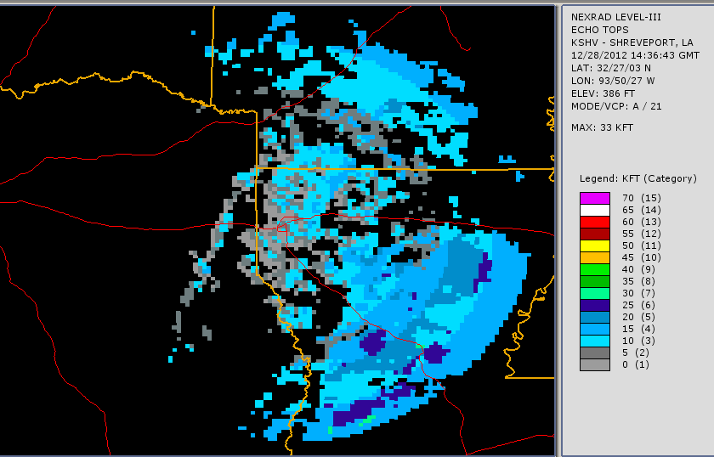
This Echo Tops display shows the serrated, or bull’s eye, appearance.

Slide 133
Different products show different data. Base reflectivity shows reflectivity in the lowest layer. Composite reflectivity shows the greatest reflectivity value in any layer.
Base:
Composite:

Slide 134
The NEXRAD radars process data in sectors. Because the beam spreads, the sectors farther away from the radar will be wider than the sectors nearer to the radar.

Slide 135
As the cells nearer the radar have better resolution than those more distant, cells further away will appear on the display as more intense than those nearer to the radar. The cells on the previous slide were identical - below is a representation of how the cell would look different based on its location. Because of this difference, it is common for storms to be mistakenly interpreted as dissipating as they approach the NEXRAD and strengthening as they move away from the NEXRAD.

Slide 136
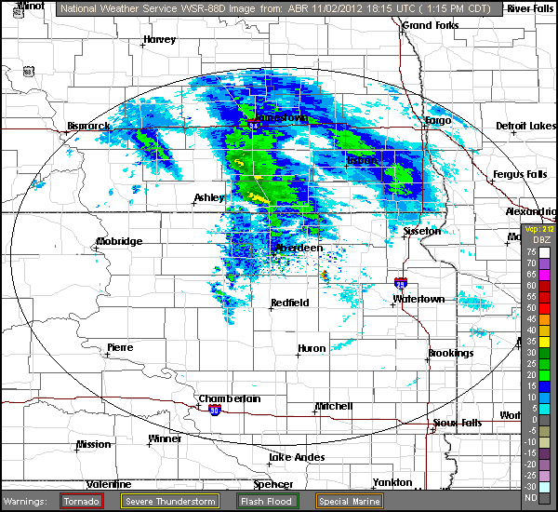
Precipitation is usually not present for base reflectivity values of less than 15dBz.

Slide 137
Precipitation Intensity can be ESTIMATED based on reflectivity.
Reflectivity | Stratiform (Rain) | Convective (Rain showers, Thunderstorms)
15 dBZ | Light | Light
20 dBZ | Light | Light
25 dBZ | Light | Light
30 dBZ | Moderate | Light
35 dBZ | Moderate | Moderate
40 dBZ | Heavy | Heavy
45 dBZ | Heavy | Heavy
50 dBZ | Heavy | Heavy
55 dBZ | Heavy | Heavy
60 dBZ | Heavy | Heavy

Slide 138
Velocity Displays show movement toward or away from the radar. The location of the radar must be considered when analyzing velocity data.

Slide 139
In a typical display from the Aviation Weather Center, green shades represent winds blowing toward the radar, and red shades depict winds blowing away from the radar. Grey shades depict areas where movement is neither toward nor away from the radar, or movement toward or away is very little.
A southerly wind would typically generate a velocity pattern similar to that on the right.

Slide 140
Lower wind speeds will have a greater area depicted with low velocities than higher wind speeds. Of the two velocity depictions below, the one on the left depicts a lower wind speed.

Slide 141
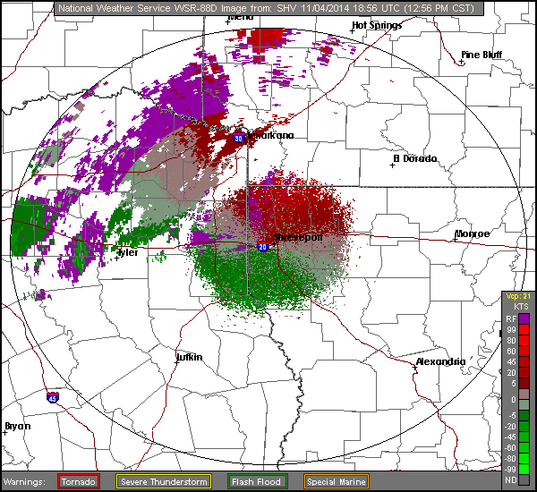
On this image, winds are from the south-southwest.

Slide 142
The same pattern on a velocity display can mean different things, depending upon its position relative to the radar.
Rotation or Shear
Updraft
Downdraft (Microburst)

Slide 143
As the elevation of the radar beam increases with distance from the radar, velocity information further from the center of the beam will pertain to winds at a higher elevation. This allows wind shear to be determined based on non-uniform patterns.

Slide 144
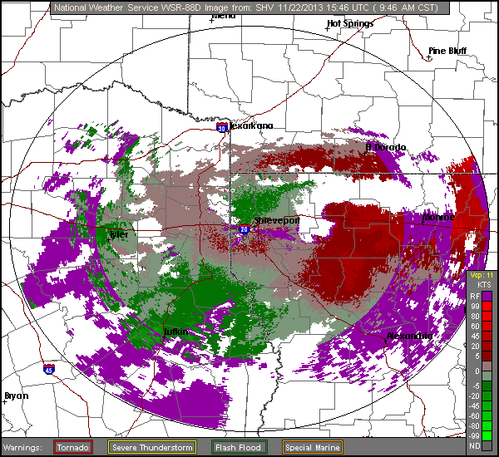
On this velocity display from KSHV after frontal passage, winds near the surface (represented by a black arrow) are from the north, while winds aloft (represented by a blue-grey arrow) are from the west-southwest.

Slide 145
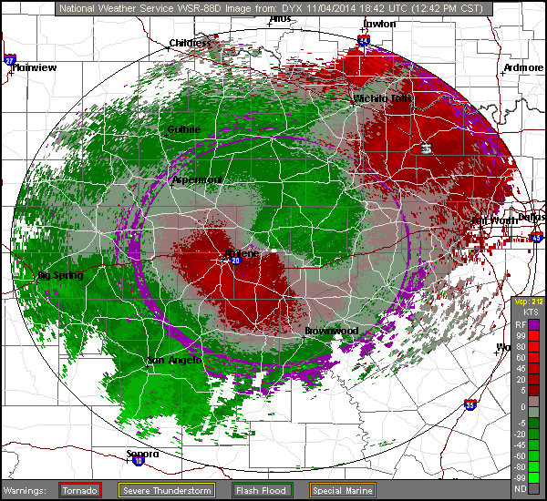
On this velocity display from KDYX after frontal passage, winds near the surface (represented by a black arrow) are from the northeast, while winds aloft (represented by a blue-grey arrow) are from the southwest.

Slide 146
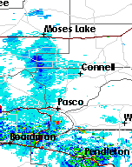
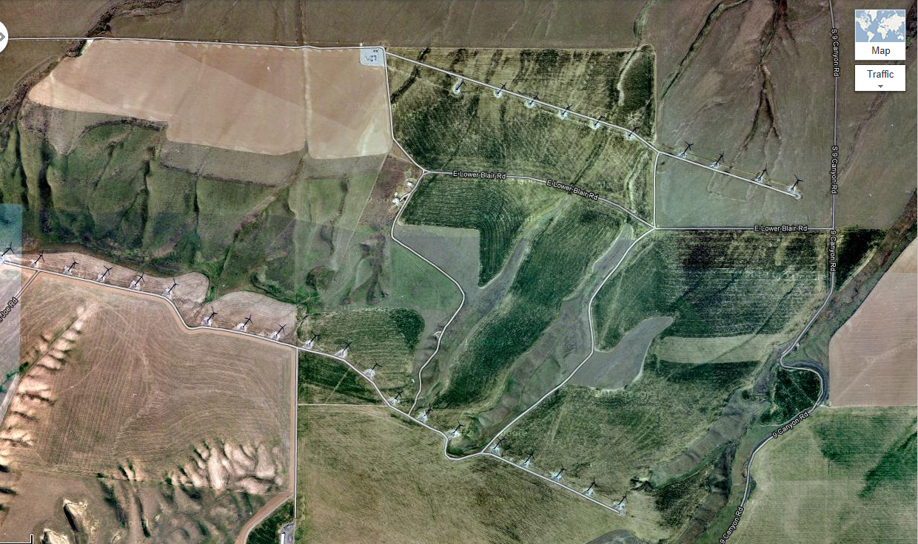
Wind farms will often show up on Base Reflectivity, as will mountains. Wind farms and mountains will not move; if the area moves, it is likely precipitation. The area of high reflectivity south of Pasco on this Base Reflectivity display corresponds to the wind farm pictured below.

Slide 147
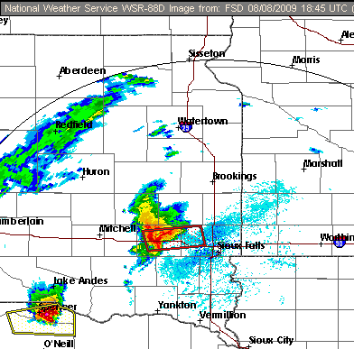
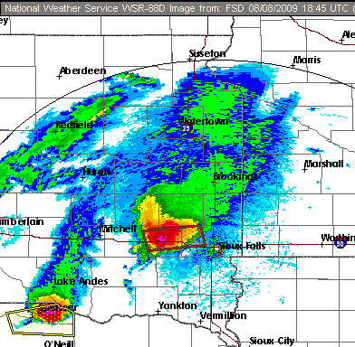
Base Reflectivity
Composite Reflectivity
Different displays have different uses. In this example, the “Hook” is evident in the Base Reflectivity shot, but not the Composite Reflectivity shot. The strong precipitation cores are evident in the Composite Reflectivity shot.

Slide 148
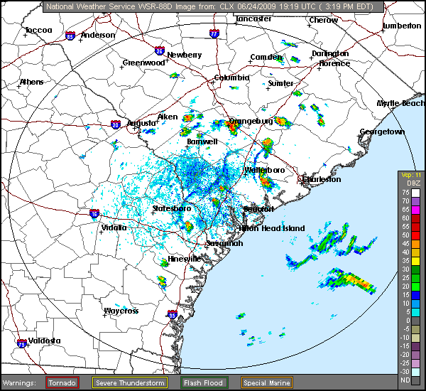
Several Outflow Boundaries are visible in this Base Reflectivity Image.

Slide 149
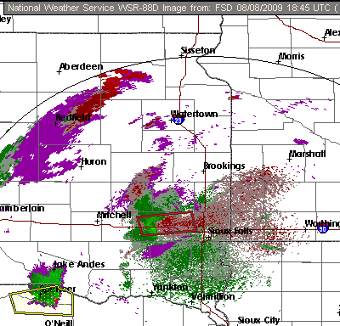
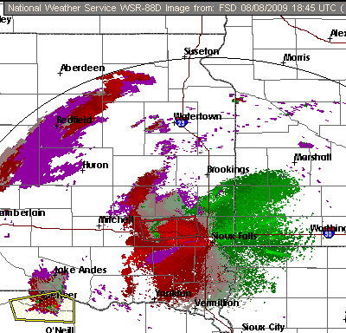
Base Velocity
Storm Relative Velocity (SRV)
Base Velocity displays the average velocity toward or away from the radar at the lowest level. Storm Radial Velocity displays the greatest velocity, with storm movement subtracted. This allows in-storm circulations to be examined.

Slide 150
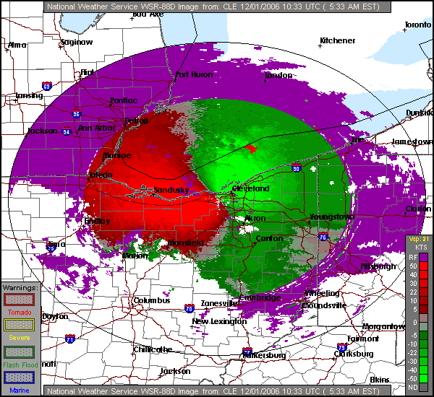
Stereotypical signature of a Microburst. The red semicircle has the flat side perpendicular to the radar’s outbound radial.
Notes:
150

Slide 151
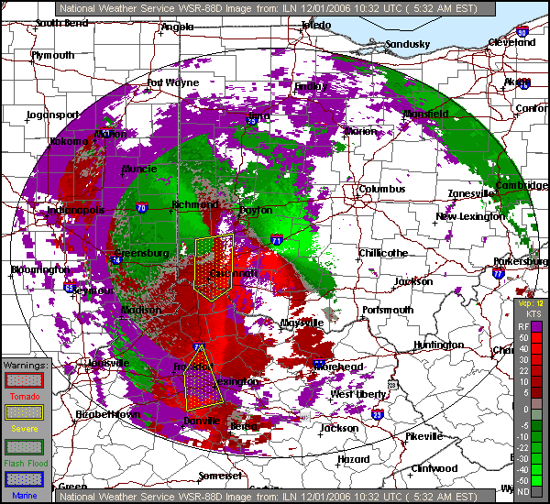
Indicative of an area of rotation on an SRV shot. (Probably not tornadic in this case, but over 30kts of shear is present.)
Notes:
151

Slide 152
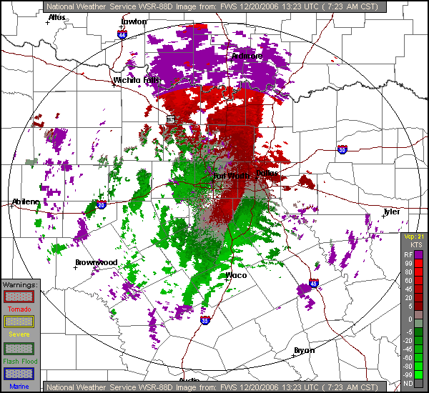
Frontal Boundary / Wind Shift
Notes:
152

Slide 153
The shape of a thunderstorm’s echo can help determine its severity.
Non-contouring Thunderstorm
Severe Thunderstorm with notch contour

Slide 154
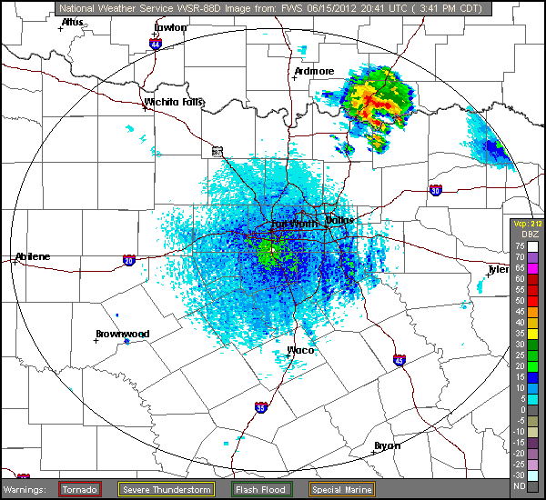
The notch is evident in the storm on this Base Reflectivity image.

Slide 155
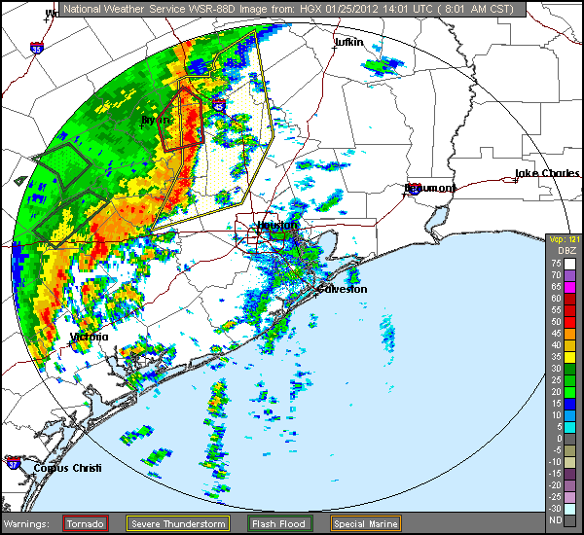
Line Echo Wave Patterns and Bow Echoes are also considered “contouring”, and indicate severe thunderstorms.

Slide 156
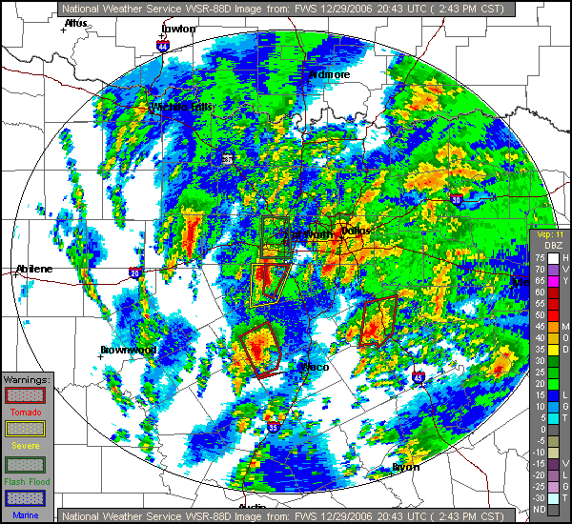
The Red Polygons are current Tornado Warnings, indicating that the National Weather Service believes Tornadic Activity is present at those locations.
Notes:
156

Slide 157
Two obvious “hook echoes” are present on this Base Reflectivity shot.
Notes:
157

Slide 158
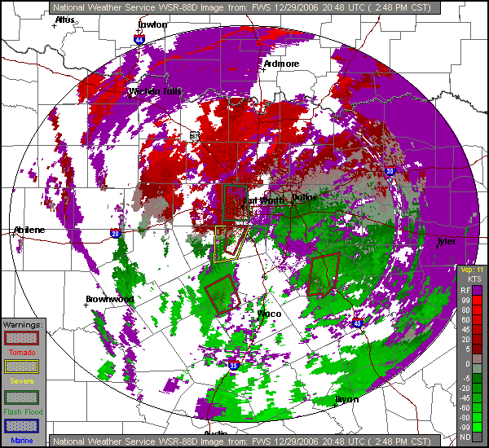
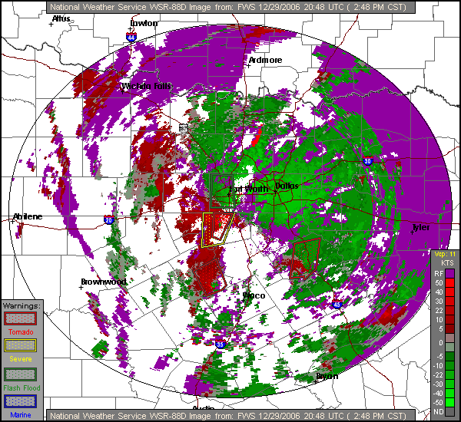
The shot on the left is a Base Velocity shot from Spinks Airport. The one on the right is a Storm Radial Velocity (SRV) Depiction from the same radar at the same time. Base Velocity shows wind velocity relative to the radar site, while SRV subtracts the storms relative movement from the wind radials, showing the wind behavior relative to that moving air mass.
Notes:
158

Slide 159
An area of updrafts on the SRV shot appears to be developing rotation, and is likely a developing severe storm. As the shear line is not aligned with a radial from the radar, it is not likely to be tornadic rotation at this point.
In this comparison of Base Velocity (left) and SRV (right) shots, although wind shear is evident due to the change in shade of green on the Base Velocity shot, tornadic rotation is more evident on the SRV shot. The rotation in the northern warning area is more evident on the Base Velocity Diagram than the southern areas.
Notes:
159

Slide 160
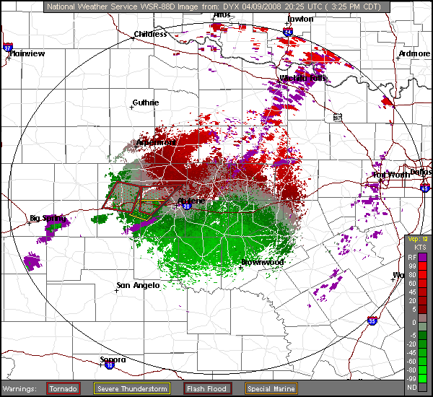
This picture is from the Dyess AFB Base Velocity display just after the NWS has issued a Tornado warning. A inbound/outbound couplet is circled in blue.
The boundary between the couplets (shown with the dotted blue line) intersects the radial at about 45 degrees, indicating upward motion and rotation.

Slide 161
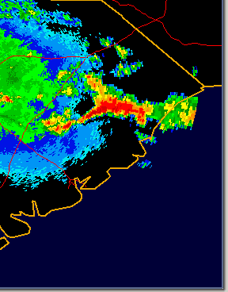
A severe thunderstorm is evident in this Base Reflectivity display from September 25, 2009
HYX
GGE
CHS

Slide 162
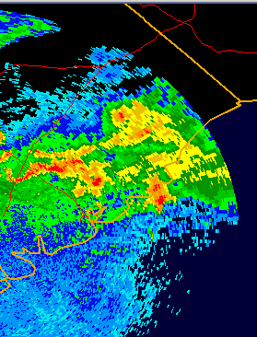
Strong precipitation, likely resulting in very low visibilities are evident in this shot from a few hours later.
HYX
GGE
CHS

Slide 163
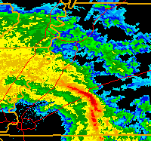
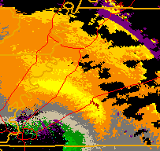
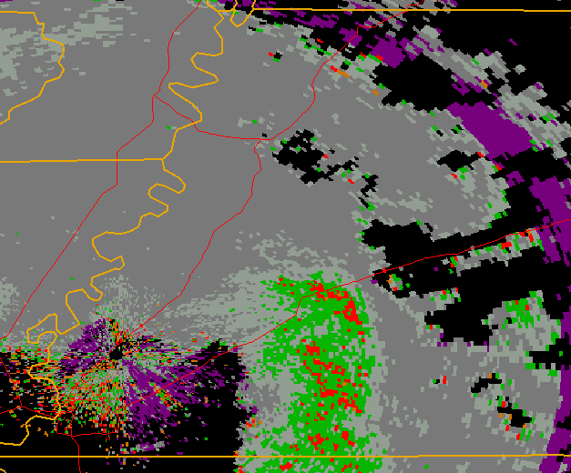
A line of thunderstorms on the Base Reflectivity shot is accompanied by 36 knot winds on the Base Velocity shot and 12 knot wind variances on the Spectrum Width shot from the morning of March 25, 2010.
99TN
99TN
99TN

Slide 164
Satellite

Slide 165
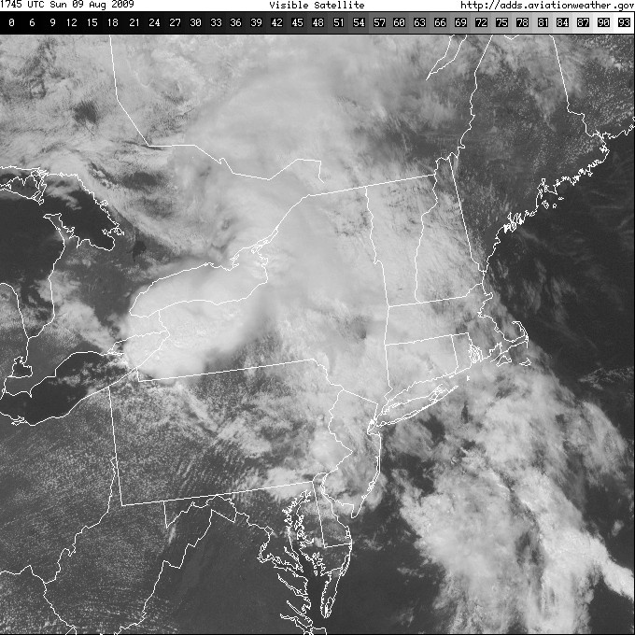
A Visual Satellite picture displays reflected light in or near the spectrum visible to the human eye. Altitude of the cloud tops is often difficult to ascertain.

Slide 166
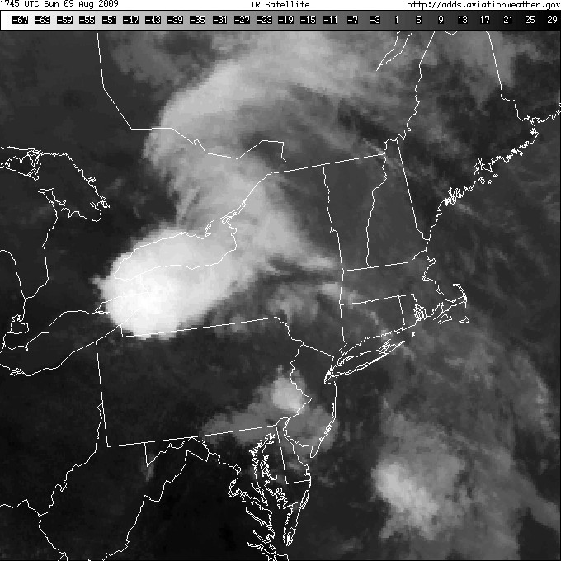
The infrared satellite picture displays reflected heat energy. Most infrared satellite shots are displayed as negatives - that is, the more energetic / warmer areas are displayed as black, and less energetic / cooler areas are displayed as white.

Slide 167
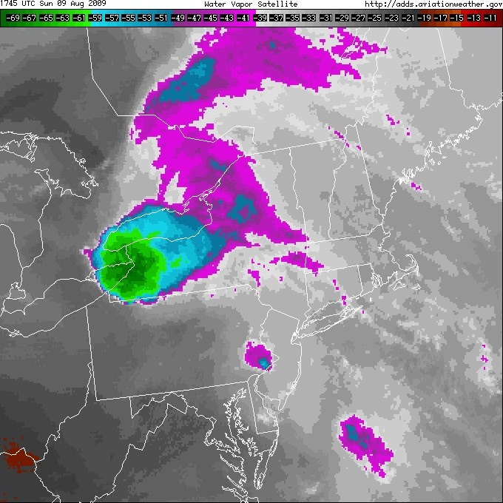
The Water Vapor shot displays the available Water Vapor in the atmosphere. Most of the shots focus near 24,000 feet, so this particular shot may not have a lot of use for HEMS forecasting.

Slide 168
Different satellite shots can be useful for different purposes. Of course, most Geostationary satellite visual shots are useless at night. It may also be hard to determine land/water boundaries during thermal cross-over (approximately 1-2 hours after sunrise/sunset,) on Infrared satellite shots.

Slide 169
Low clouds indicating moderate turbulence over southern Pennsylvania are evident on the Visual shot, but not the Infrared shot.

Slide 170
The thunderstorm top over Western New York is more obvious on the Infrared shot than the visual shot.

Slide 171
An area of cloudiness on the Visual shot that looks cloud-free on the Infrared shot indicates low clouds or fog. In this case, ceilings were 1,500 to 2,000 feet in northern New Jersey.

Slide 172
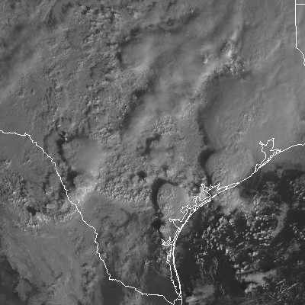
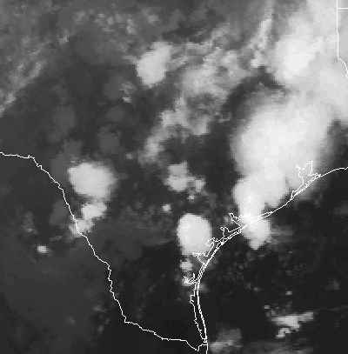
The top of a thunderstorm building through the anvil can be seen in the visual satellite image.

Slide 173
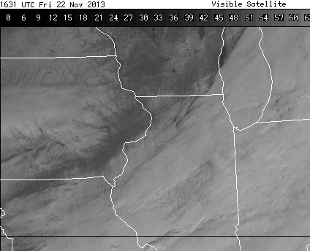
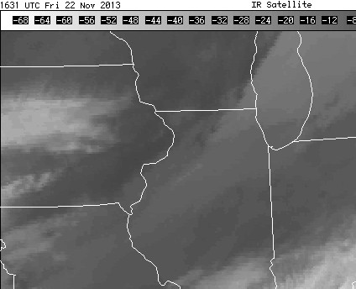
The visible lakes and rivers in Minnesota, Iowa, and Wisconsin show us that the light colors on the visual shot in those places is snow, not low clouds or fog.

Slide 174
Upper Air Reports

Slide 175
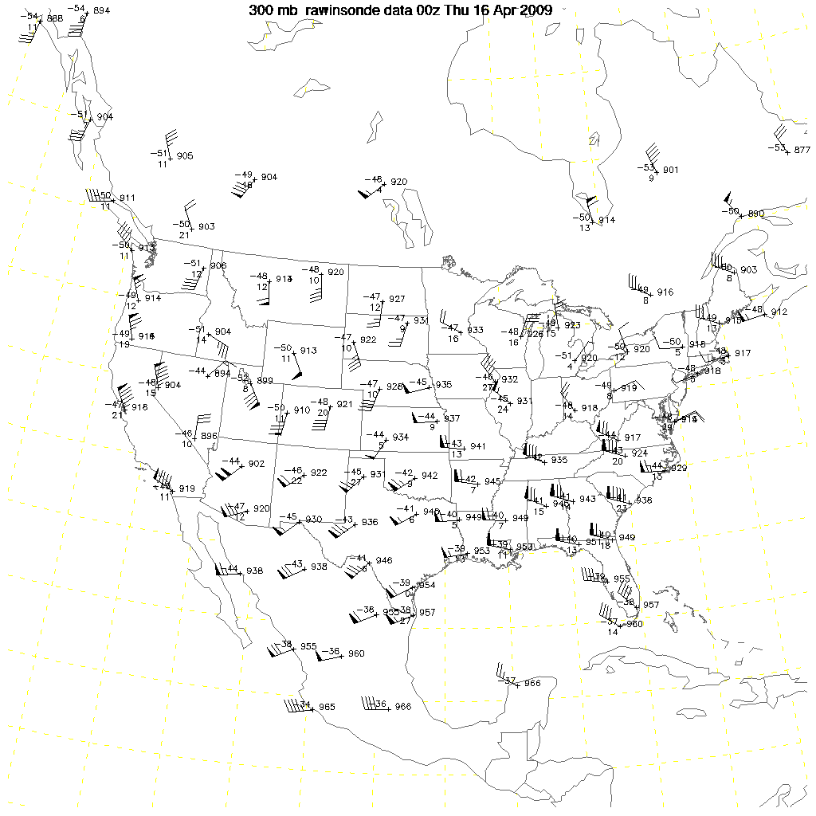
Constant Pressure Charts are plotted using the Mandatory Levels from the soundings

Slide 176
The plots on the constant pressure charts contain information from the soundings, including height of that pressure, wind speed and direction, and temperature and dew point depression.
On this 300mb chart, the height of the 300mb level over KABQ is 9220 meters, the temperature is -46°C, the dew point depression is 22°C, making the dew point - 68°C, and winds are from approximately 240° true at 60 knots.

Slide 177
Skew-T values are based on pressure. For calculations not requiring precision, the table below can be used for altitude approximation:

Slide 178
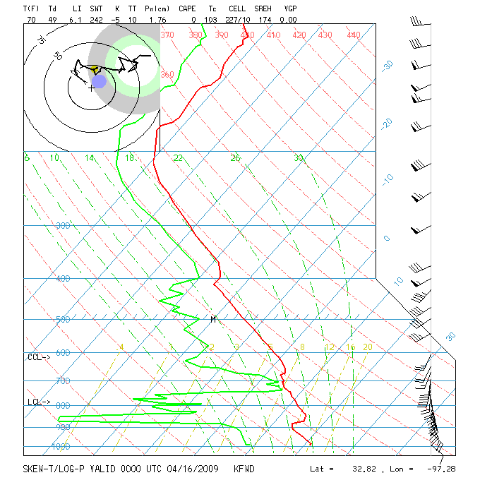
The RED plotted line represents the temperature at a given pressure level
The Green plotted line represents the dew point at a given pressure level.

Slide 179
The temperature stops decreasing with height at the tropopause
The freezing level is where the temperature plot crosses the 0° Celsius line.
Clouds may be found where the dew point and temperature plots are close.

Slide 180
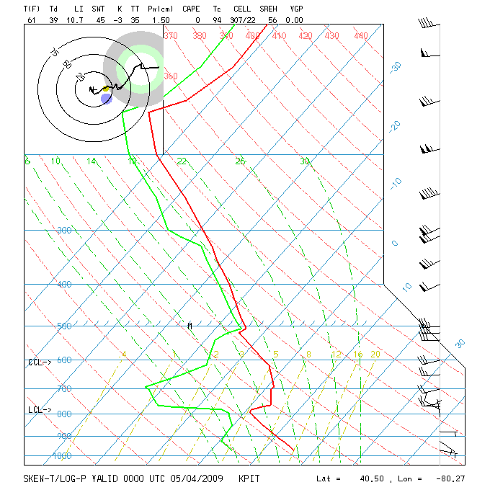
If the temperature and dew point are close and the temperature is less than 0° Celsius, icing becomes a concern
Freezing Level

Slide 181
Icing and Turbulence

Slide 182
Icing occurs when super-cooled water droplets come into contact with a solid, and freeze on that surface. Super-cooled water can only exist between 0 and -40 degrees Celsius, so icing does not need to be considered outside of that temperature range.
40
No Icing
20
0
Possible Icing
-20
No Icing
-40

Slide 183
Icing is most likely when the temperature is between 0 degrees Celsius and -20 degrees Celsius.
40
No Icing
20
0
Icing most likely
-20
Possible Icing
-40
No Icing

Slide 184
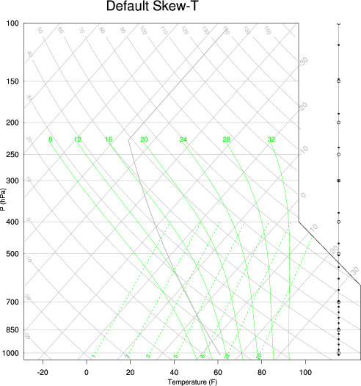
As you can see, the areas where icing is probable and icing is possible, given sufficient moisture, cover a significant area of the Skew-T.

Slide 185
For super-cooled water droplets to exist in sufficient quantities to be of concern, the moisture must be visible in most cases.
Clouds are visible moisture.
Fog is visible moisture.
Rain is visible moisture.
Drizzle is visible moisture.
Snow is NOT visible moisture.
Ice Pellets are not visible moisture, but super-cooled water drops must exist above for it to occur.

Slide 186
If the air is calm, it is possible for the air to be super-saturated without the moisture being visible. If the air is calm, super-saturated, and temperatures are below freezing,
Frost will form on stationary objects.
Movement through the air will result in moisture freezing on objects.

Slide 187
Icing can affect aircraft in many ways:
Adds weight.
Clogs intakes and inlets, reducing engine efficiency.
Changes airfoil shape, reducing aerodynamic efficiency.
Reduces visibility through the windshield and windows.
Clogs pitot-static system, causing erroneous instrument readings.

Slide 188
There are many MEL items that restrict the fixed wing aircraft from flying into known or forecast icing conditions, such as heaters and deice equipment.

Slide 189
During the winter months, low ceilings that prevent VFR flights may also cause icing, preventing IFR flights. As the lowest IFR altitudes are 3,000 and 4,000 feet, icing could be a factor even with surface temperatures above freezing.

Slide 190
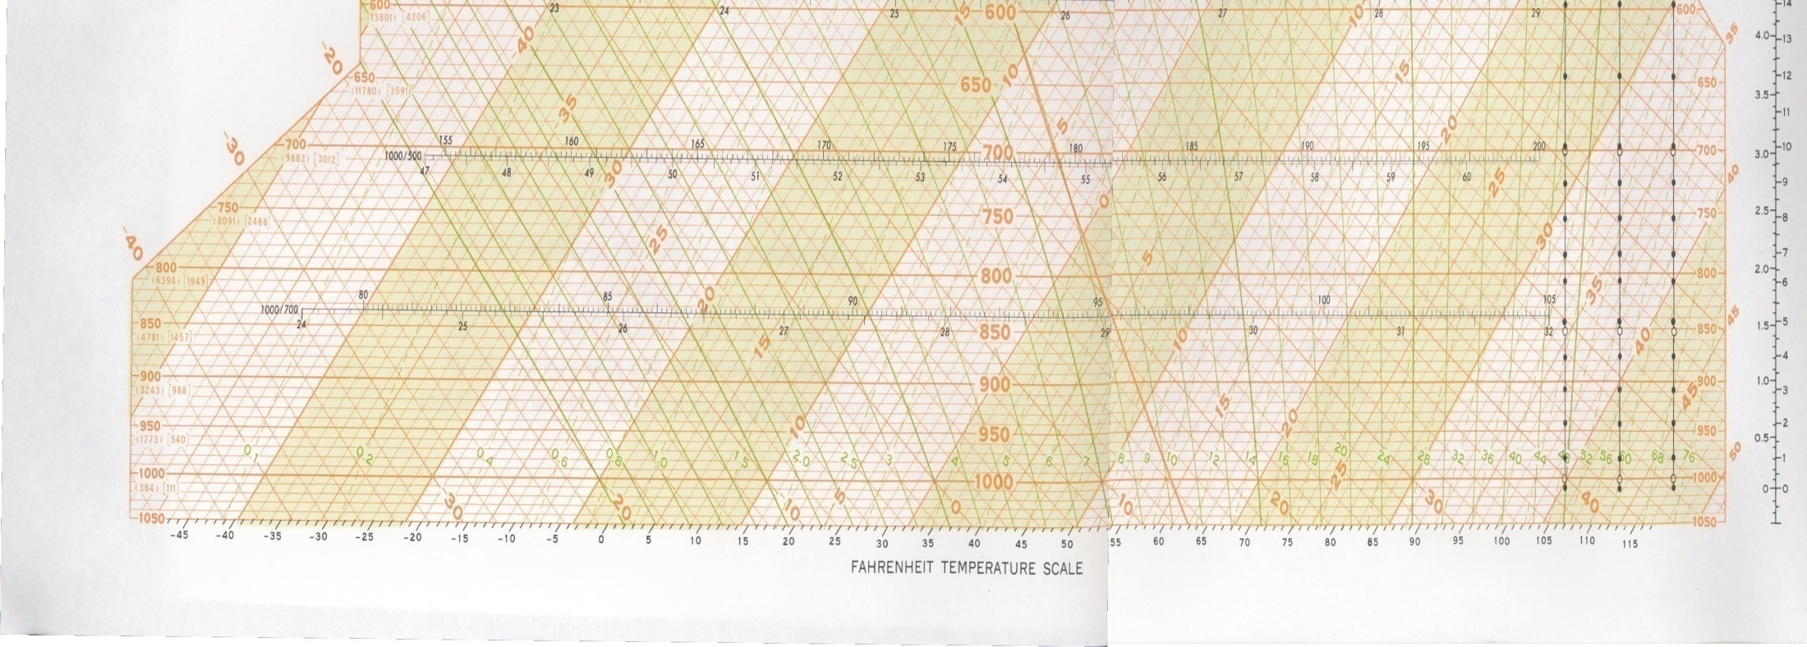
Using a Skew-T diagram, we can see that temperatures at 4,000 feet could be at or below freezing with surface temperatures as warm as 6 degrees Celsius with a moist atmosphere.
Freezing at 4,000 ft msl
6 degrees C at 350 ft msl

Slide 191
METAR observations may contain information showing observed icing.
Freezing rain of any intensity (FZRA) implies severe icing.
Unless it is very light, freezing drizzle (FZDZ) also implies severe icing.
Freezing fog (FZFG) implies icing of unknown intensity.

Slide 192
Snow is frozen water. As it is already frozen, it will not freeze onto aircraft surfaces causing icing.
Air temperatures need to be above freezing to melt snow. Thus, icing is not a hazard where snow is melting into rain as it falls.
Ice pellets are formed by refreezing rain. Icing should be assumed in the layer where the ice pellets are forming.

Slide 193
Although Snow does not imply icing, the aircraft must be free of frost, ice, and snow before beginning take-off. This may be ascertained by direct observation, or by having de-icing fluid applied within the time given by the appropriate Hold Over Table.

Slide 194
Turbulence is caused by the non-uniform movement of air.
Wind Shear occurs when winds of different speeds or directions flow next to each other.
Mechanical turbulence occurs when winds flow around obstructions.
Convective turbulence occurs when pockets of air are heated at the surface and rise through the air mass.

Slide 195
Severe or extreme turbulence can damage or destroy airborne aircraft. Low level wind shear can make landings and take-offs dangerous and unpredictable.

Slide 196
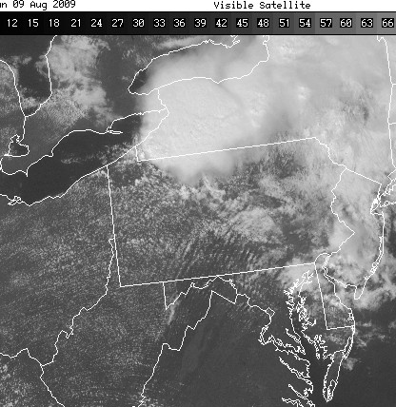
Waves in cloud formations are indicators of turbulence.

Slide 197
USAF turbulence forecast chart

Slide 198
Mountain Wave Turbulence is frequently reported when strong winds at mountain top level (>35 knot vector perpendicular to the mountain range) flow over a colder layer on the downwind side of the mountain range.
Mountain Wave turbulence is dangerous, not only in its intensity, but in the unpredictability of the airflow.
Colder, Calmer, Air

Slide 199
Friction along the inversion boundary causes waves, disrupting airflow patterns downwind of the range. Air flowing through passes and air deflected into the colder air mass can wreak havoc with the expected air flow. Although 35 knots of wind near the surface is not usually considered enough for severe turbulence, in Mountain Wave conditions the turbulence can be strong enough to cause a loss of control.

Slide 200
A “back-door” cold front with strong winds at the ridge line may set up conditions for Mountain Wave turbulence. Along the Rockies in the southwestern US, the 700mb wind chart may be useful for a quick estimation of winds along the ridgeline. If the example below were in New Mexico, Mountain Wave turbulence east of the ridgeline would not be unexpected.
L
Stable, Cold Air
700mb winds

Slide 201
Wind Plots on upper air charts can be used to find areas of likely turbulence at those altitudes. In this case, it looks like about a 120 knot vector difference between the KDRA and KFLG soundings over a distance of about 300nm. We can expect turbulence in this area at FL300 based on this chart. Opposing winds are also seen over the Virginia/North Carolina area, although not as strong.

Slide 202
Known vs Forecast
Known: | Forecast:
Pilot Reports (PIREPS) | AIRMETS
Aircraft Reports (AIREPS) | SIGMETS
Surface Observations | TAFS

Slide 203
Pilot Reports (PIREPS) and Aircraft Reports (AIREPS)
Pilot Reports (PIREPS) are reports of weather conditions from the pilot of an aircraft in flight. Usually they are relayed through ATC, although they may be relayed through other means.
Aircraft Reports (AIREPS) are reports of weather conditions from an aircraft in flight, and may be done automatically.

Slide 204
Decoding PIREPs
DLN UA /OV DLN135020/TM 1130/FL115/TP C180/SK SCT150
/WX FV99SM/TB NEG/RM HZ IN VLYS
JER UA /OV TWF300025/TM 1229/FL095/TP PC12
/TB MOD 095-072/RM ATC DURD TWF
The first item in a PIREP is the three letter identifier of the station transmitting the PIREP, which is usually at an airport. In this case, the first PIREP was transmitted from Dillon, Montana, and the second was transmitted from Jerome, Idaho.

Slide 205
Decoding PIREPs
DLN UA /OV DLN135020/TM 1130/FL115/TP C180/SK SCT150
/WX FV99SM/TB NEG/RM HZ IN VLYS
JER UA /OV TWF300025/TM 1229/FL095/TP PC12
/TB MOD 095-072/RM ATC DURD TWF
The second item in a PIREP will be the letters UA for non-severe PIREPs, or UUA for urgent PIREPs. PIREPs reporting hazardous phenomena are considered urgent. Hazardous phenomena includes tornadic activity, hail, severe icing, and severe or extreme turbulence.

Slide 206
DLN UA /OV DLN135020/TM 1130/FL115/TP C180/SK SCT150
/WX FV99SM/TB NEG/RM HZ IN VLYS
JER UA /OV TWF300025/TM 1229/FL095/TP PC12
/TB MOD 095-072/RM ATC DURD TWF
The third item in a PIREP is the location of the phenomena being reported. It can be a point, or a radial and distance from a point. In the first example, the location is 20NM southeast of Dillon, Montana. In the second example, the location is 25NM west-northwest of Twin Falls, Idaho.

Slide 207
Decoding PIREPs
DLN UA /OV DLN135020/TM 1130/FL115/TP C180/SK SCT150
/WX FV99SM/TB NEG/RM HZ IN VLYS
JER UA /OV TWF300025/TM 1229/FL095/TP PC12
/TB MOD 095-072/RM ATC DURD TWF
The time of the PIREP is reported next. All times are reported using UTC.

Slide 208
Decoding PIREPs
DLN UA /OV DLN135020/TM 1130/FL115/TP C180/SK SCT150
/WX FV99SM/TB NEG/RM HZ IN VLYS
JER UA /OV TWF300025/TM 1229/FL095/TP PC12
/TB MOD 095-072/RM ATC DURD TWF
The altitude of the aircraft (MSL, in hundreds of feet,) is reported next.

Slide 209
Decoding PIREPs
DLN UA /OV DLN135020/TM 1130/FL115/TP C180/SK SCT150
/WX FV99SM/TB NEG/RM HZ IN VLYS
JER UA /OV TWF300025/TM 1229/FL095/TP PC12
/TB MOD 095-072/RM ATC DURD TWF
The last mandatory item is aircraft type. There are specific codes for each aircraft, with codes limited to four characters. For examples, the code for the AS350 is AS50; the code for the EC145 is BK17.

Slide 210
Decoding PIREPs
There are seven optional items that can be reported. A PIREP must contain at least one of the optional items.
Element Indicator | Element
/SK | Sky Condition
/WX | Weather and Flight Visibility
/TA | Air Temperature
/WV | Wind Direction and Speed
/TB | Turbulence
/IC | Icing
/RM | Remarks

Slide 211
Decoding PIREPs
DLN UA /OV DLN135020/TM 1130/FL115/TP C180
/SK SCT150/WX FV99SM/TB NEG/RM HZ IN VLYS
JER UA /OV TWF300025/TM 1229/FL095/TP PC12
/TB MOD 095-072/RM ATC DURD TWF
In the above examples, we see that the Cessna 180 pilot reported that the sky condition was scattered at 15,000ft, with unrestricted flight visibility, no turbulence, and haze in the valleys below. The PC12 pilot reported moderate turbulence from 9,500 feet down to 7,200 feet during his descent into Twin Falls

Slide 212
Decoding AIREPs
ARP UAL559 3304N 12431W 1648 F360 M51 350/020
ARP DAL1197 3304N 12431W 1649 F370 M52 350/028 TB SMTH
ARP UAL1275 3604N 11509W 1650 F350 M41 206/055 TB SMTH SK CLEAR
ARP ASA835 3536N 12556W 1651 F350 M50 328/030
The first item in a AIREP are the letters ARP.

Slide 213
Decoding AIREPs
ARP UAL559 3304N 12431W 1648 F360 M51 350/020
ARP DAL1197 3304N 12431W 1649 F370 M52 350/028 TB SMTH
ARP UAL1275 3604N 11509W 1650 F350 M41 206/055 TB SMTH SK CLEAR
ARP ASA835 3536N 12556W 1651 F350 M50 328/030
The second item in an AIREP is the aircraft’s identification. This identification usually corresponds to a specific flight number. Looking up the flight numbers shows that three of the four flights above are headed to Hawaii.

Slide 214
Decoding AIREPs
ARP UAL559 3304N 12431W 1648 F360 M51 350/020
ARP DAL1197 3304N 12431W 1649 F370 M52 350/028 TB SMTH
ARP UAL1275 3604N 11509W 1650 F350 M41 206/055 TB SMTH SK CLEAR
ARP ASA835 3536N 12556W 1651 F350 M50 328/030
The latitude and longitude follow the call sign.

Slide 215
Decoding AIREPs
ARP UAL559 3304N 12431W 1648 F360 M51 350/020
ARP DAL1197 3304N 12431W 1649 F370 M52 350/028 TB SMTH
ARP UAL1275 3604N 11509W 1650 F350 M41 206/055 TB SMTH SK CLEAR
ARP ASA835 3536N 12556W 1651 F350 M50 328/030
The time of the report follows the position.

Slide 216
Decoding AIREPs
ARP UAL559 3304N 12431W 1648 F360 M51 350/020
ARP DAL1197 3304N 12431W 1649 F370 M52 350/028 TB SMTH
ARP UAL1275 3604N 11509W 1650 F350 M41 206/055 TB SMTH SK CLEAR
ARP ASA835 3536N 12556W 1651 F350 M50 328/030
The altitude (MSL) or flight level follows the time of the report.

Slide 217
Decoding AIREPs
ARP UAL559 3304N 12431W 1648 F360 M51 350/020
ARP DAL1197 3304N 12431W 1649 F370 M52 350/028 TB SMTH
ARP UAL1275 3604N 11509W 1650 F350 M41 206/055 TB SMTH SK CLEAR
ARP ASA835 3536N 12556W 1651 F350 M50 328/030
The temperature follows the altitude. The “M” at the beginning of the temperatures above indicates a negative temperature.

Slide 218
Decoding AIREPs
ARP UAL559 3304N 12431W 1648 F360 M51 350/020
ARP DAL1197 3304N 12431W 1649 F370 M52 350/028 TB SMTH
ARP UAL1275 3604N 11509W 1650 F350 M41 206/055 TB SMTH SK CLEAR
ARP ASA835 3536N 12556W 1651 F350 M50 328/030
Winds follow the temperature, with direction given in magnetic degrees instead of true degrees.

Slide 219
Decoding AIREPs
ARP UAL559 3304N 12431W 1648 F360 M51 350/020
ARP DAL1197 3304N 12431W 1649 F370 M52 350/028 TB SMTH
ARP UAL1275 3604N 11509W 1650 F350 M41 206/055 TB SMTH SK CLEAR
ARP ASA835 3536N 12556W 1651 F350 M50 328/030
Other information can be included, using SK, WX, TB, and IC headers.

Slide 220
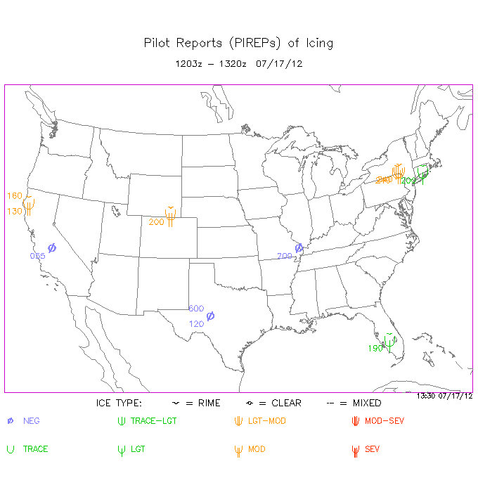
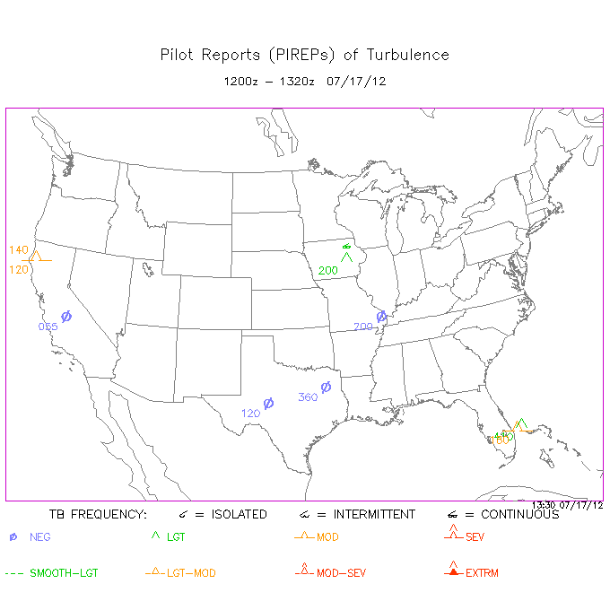
Pireps can also be viewed graphically at http://www.aviationweather.gov/adds/pireps

Slide 221
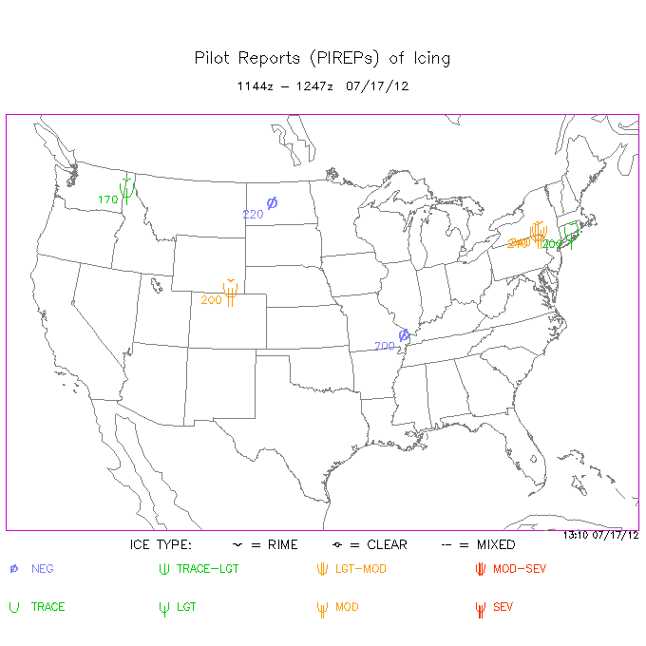
The date and time range during which the PIREPS were collected will be displayed at the top of the form.

Slide 222
A key to the symbols used will be displayed at the bottom of the form.

Slide 223
This PIREP for moderate rime icing at FL200 can be considered “known icing”.

Slide 224
Turbulence PIREP charts are labeled similarly to Icing PIREP charts.

Slide 225
This PIREP for continuous light turbulence can be considered “known turbulence.”

Slide 226
Airmen’s Meteorological Advisories (AIRMETS) and Significant Meteorological Advisories (SIGMETS) are advisories of hazardous weather conditions. SIGMETS cover conditions that are more hazardous than AIRMETS. For example, moderate turbulence would be covered by an AIRMET, while severe turbulence would be covered by a SIGMET. Conditions described by AIRMETS and SIGMETS are considered “forecast.”

Slide 227
AIRMET bulletins for the United States will always start with WAUS. SIGMET bulletins for the United States will always start with WSUS.
WAUS45 KKCI 170845
SLCZ WA 170845
AIRMET ZULU UPDT 1 FOR ICE AND FRZLVL VALID UNTIL 171500
AIRMET ICE...ID MT WA OR
FROM YDC TO 70SSW YXH TO GTF TO 40SW HLN TO PDT TO YKM TO YDC MOD ICE BTN 130 AND FL250. CONDS CONTG BYD 15Z ENDG 15-18Z. FRZLVL...RANGING FROM 125-160 ACRS AREA

Slide 228
The header will also contain the date and time of issue in UTC.
WAUS45 KKCI 170845
SLCZ WA 170845
AIRMET ZULU UPDT 1 FOR ICE AND FRZLVL VALID UNTIL 171500
AIRMET ICE...ID MT WA OR
FROM YDC TO 70SSW YXH TO GTF TO 40SW HLN TO PDT TO YKM TO YDC MOD ICE BTN 130 AND FL250. CONDS CONTG BYD 15Z ENDG 15-18Z. FRZLVL...RANGING FROM 125-160 ACRS AREA

Slide 229
AIRMET ZULU indicates that the AIRMET is for icing. AIRMET TANGO indicates that the AIRMET is for turbulence. AIRMET SIERRA indicates that the AIRMET is for obstructions and/or IMC.
WAUS45 KKCI 170845
SLCZ WA 170845
AIRMET ZULU UPDT 1 FOR ICE AND FRZLVL VALID UNTIL 171500
AIRMET ICE...ID MT WA OR
FROM YDC TO 70SSW YXH TO GTF TO 40SW HLN TO PDT TO YKM TO YDC MOD ICE BTN 130 AND FL250. CONDS CONTG BYD 15Z ENDG 15-18Z. FRZLVL...RANGING FROM 125-160 ACRS AREA

Slide 230
A Valid Time will be included in the AIRMET. The AIRMET should not be used after that time, as a newer one should be available if necessary.
WAUS45 KKCI 170845
SLCZ WA 170845
AIRMET ZULU UPDT 1 FOR ICE AND FRZLVL VALID UNTIL 171500
AIRMET ICE...ID MT WA OR
FROM YDC TO 70SSW YXH TO GTF TO 40SW HLN TO PDT TO YKM TO YDC MOD ICE BTN 130 AND FL250. CONDS CONTG BYD 15Z ENDG 15-18Z. FRZLVL...RANGING FROM 125-160 ACRS AREA

Slide 231
The states affected by the AIRMET will be listed in the body of the advisory.
WAUS45 KKCI 170845
SLCZ WA 170845
AIRMET ZULU UPDT 1 FOR ICE AND FRZLVL VALID UNTIL 171500
AIRMET ICE...ID MT WA OR
FROM YDC TO 70SSW YXH TO GTF TO 40SW HLN TO PDT TO YKM TO YDC MOD ICE BTN 130 AND FL250. CONDS CONTG BYD 15Z ENDG 15-18Z. FRZLVL...RANGING FROM 125-160 ACRS AREA

Slide 232
The area affected will be described using three letter airport or VORTAC identifiers.
WAUS45 KKCI 170845
SLCZ WA 170845
AIRMET ZULU UPDT 1 FOR ICE AND FRZLVL VALID UNTIL 171500
AIRMET ICE...ID MT WA OR
FROM YDC TO 70SSW YXH TO GTF TO 40SW HLN TO PDT TO YKM TO YDC MOD ICE BTN 130 AND FL250. CONDS CONTG BYD 15Z ENDG 15-18Z. FRZLVL...RANGING FROM 125-160 ACRS AREA

Slide 233
The hazard and altitudes/flight levels affected will follow.
WAUS45 KKCI 170845
SLCZ WA 170845
AIRMET ZULU UPDT 1 FOR ICE AND FRZLVL VALID UNTIL 171500
AIRMET ICE...ID MT WA OR
FROM YDC TO 70SSW YXH TO GTF TO 40SW HLN TO PDT TO YKM TO YDC MOD ICE BTN 130 AND FL250. CONDS CONTG BYD 15Z ENDG 15-18Z. FRZLVL...RANGING FROM 125-160 ACRS AREA

Slide 234
If conditions are expected to continue beyond the valid time of the AIRMET, the AIRMET will include this information.
WAUS45 KKCI 170845
SLCZ WA 170845
AIRMET ZULU UPDT 1 FOR ICE AND FRZLVL VALID UNTIL 171500
AIRMET ICE...ID MT WA OR
FROM YDC TO 70SSW YXH TO GTF TO 40SW HLN TO PDT TO YKM TO YDC MOD ICE BTN 130 AND FL250. CONDS CONTG BYD 15Z ENDG 15-18Z. FRZLVL...RANGING FROM 125-160 ACRS AREA

Slide 235
Freezing level information will be included in Icing AIRMETs.
WAUS45 KKCI 170845
SLCZ WA 170845
AIRMET ZULU UPDT 1 FOR ICE AND FRZLVL VALID UNTIL 171500
AIRMET ICE...ID MT WA OR
FROM YDC TO 70SSW YXH TO GTF TO 40SW HLN TO PDT TO YKM TO YDC MOD ICE BTN 130 AND FL250. CONDS CONTG BYD 15Z ENDG 15-18Z. FRZLVL...RANGING FROM 125-160 ACRS AREA

Slide 236
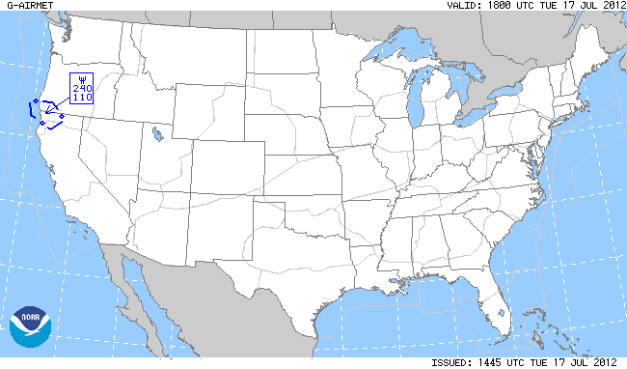
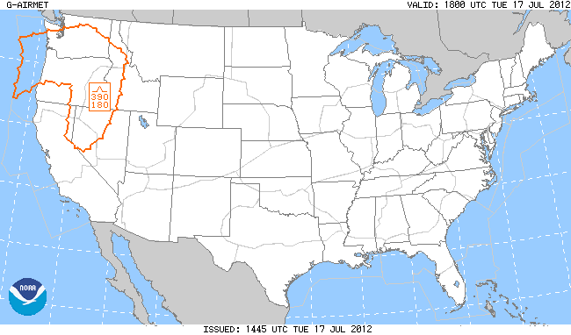
AIRMET graphics are available at http://www.aviationweather.gov/adds/airmets.

Slide 237
This graphic shows moderate icing over northwestern California and Southwestern Oregon from 11,000 feet MSL to FL240.

Slide 238
This graphic shows moderate turbulence over the northwestern United States from FL180 to FL390.

Slide 239
Some TAFs contain icing and turbulence information. Turbulence and Icing groups are six-digit groups beginning with a 5 (for turbulence) or 6 (for icing).
AMD KNZY 1903/1923 33010KT 9999 FEW120 BKN180 BKN220 641509 642402 QNH2981INS
BECMG 1907/1909 VRB06KT SCT015 BKN100 600000 QNH2983INS
TEMPO 1909/1915 BKN015
BECMG 1915/1917 30012KT FEW020 BKN120 QNH2985INS T20/1913Z T24/1923Z AMD 0306

Slide 240
641509
Indicator – 5 for Turbulence, 6 for Icing
Indicator for type and intensity
Base of layer in hundreds of feet.
Thickness of layer in thousands of feet.

Slide 241
Intensity indicators for Icing and Turbulence are shown below. An X is occasionally used to indicate extreme turbulence.
Intensity | Icing | Turbulence
None | 0 | 0
Light | 1, 2, 3 | 1
Moderate | 4, 5, 6 | 2, 3, 4, 5
Severe | 7, 8, 9 | 6, 7, 8, 9

Slide 242
In the TAF below, we see icing groups indicating moderate icing from 15,000 feet to FL260, and icing ending between 0700 and 0900 UTC.
AMD KNZY 1903/1923 33010KT 9999 FEW120 BKN180 BKN220 641509 642402 QNH2981INS
BECMG 1907/1909 VRB06KT SCT015 BKN100 600000 QNH2983INS
TEMPO 1909/1915 BKN015
BECMG 1915/1917 30012KT FEW020 BKN120 QNH2985INS T20/1913Z T24/1923Z AMD 0306

Slide 243
In the TAF below, we see turbulence groups indicating moderate turbulence from 14,000 feet to FL180, becoming light turbulence between 1400 and 1500 UTC.
TAF AMD KMIB 2001/2101 30009KT 9999 SCT140 541404 QNH2984INS
BECMG 2014/2015 35010G15KT 9999 FEW250 511404 QNH2990INS T31/2001Z T17/2009Z AMD 200100

Slide 244
Questions?
If so, email mike@mikewalsted.com

